Slide 1
Alternative Blood Collection Device (ABCD)
Ori Shemla
April 2025

Slide 2
Outline
1
Pearson correlation
2
Spearman correlation
3
Linear regression
4
Normalization considerations due to slope and intercept
5
Key highlights

Slide 3
ABCD Experiment Protocol
BioIVT will collect blood samples from 25 healthy donors over three separate days, with 8–10 donors per session.
Blood samples from each healthy donor will be collected as outlined in Appendix A: On-site Blood Collection and Plasma Preparation Protocol, and Table 1 above, following the list below:
1 x EDTA tube
3 x Cell-Free DNA BCT tubes
3 x Protein Plus BCT tubes
1 x BD Vacutainer™ Mononuclear CPT tube
Protocol # | Tube type | Location of centrifugation and plasma isolation | Shipment temperature | Time from collection to centrifugation
1* | EDTA | Point of collection | -80⁰C | Up to 4 hours
2 | VAMS | Point of collection | RT | Up to 4 hours
3 | CPT | Point of collection | -80⁰C | Up to 4 hours
4 | Streck cfDNA | OncoHost lab | RT | 24 hours
5 | Streck Protein Plus | OncoHost lab | RT | 24 hours
6 | Streck cfDNA | OncoHost lab | RT | 72 hours
7 | Streck Protein Plus | OncoHost lab | RT | 72 hours
8 | Streck cfDNA | OncoHost lab | RT | 120 hours
9 | Streck Protein Plus | OncoHost lab | RT | 120 hours

Slide 4
Cohorts – phase 1
Baseline method | Tested methods | Time to centrifuge | Number of subjects | Number of samples | Site | Details
EDTA Plasma (20) | CPT Plasma (20) STRECK-PROT+ DS (20) STRECK-cfDNA DS (20) STRECK-PROT+ (20) | 68-76 hours | 20 | 100 | BioIVT | healthy subjects aged 18+
EDTA Plasma (55) | SST Serum (55) | Up to 4 hours | 55 | 110 | Heidelberg | Patients with mNSCLC, Pre-treatment (PROPHETIC NCT04056247)
EDTA Plasma (21) | EDTA Plasma (21) (consecutive runs) | Up to 4 hours | 21 | 42 | Israeli sites | Patients with mNSCLC, Pre-treatment (OH Analytical validity)

Slide 5
Highlights

Slide 6
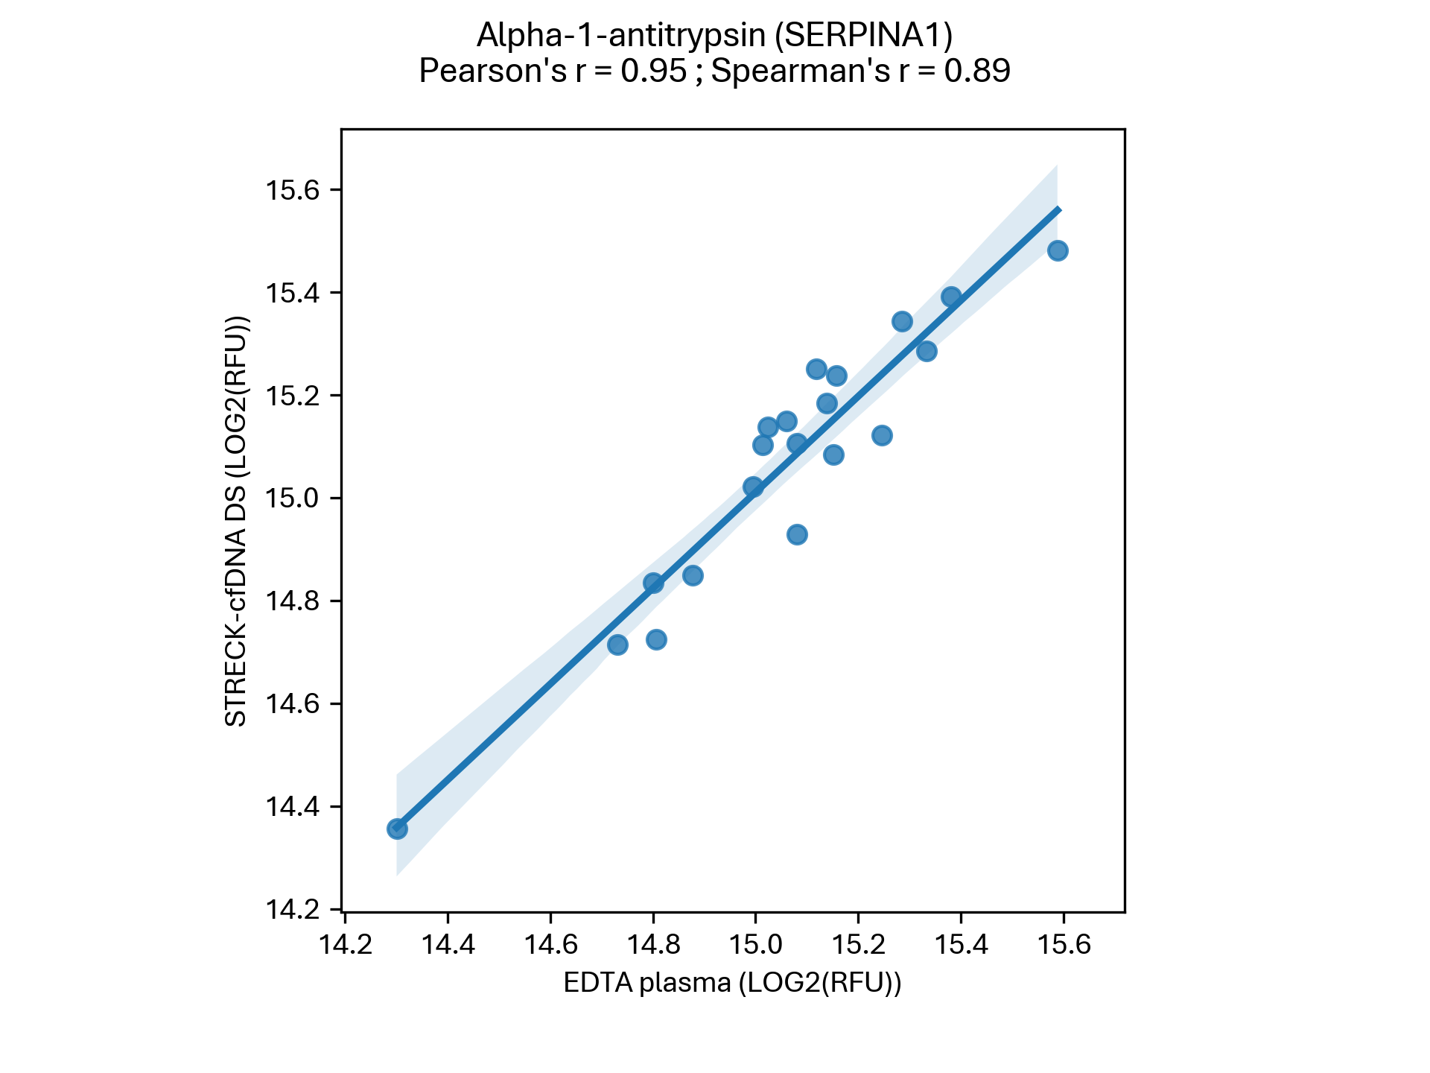
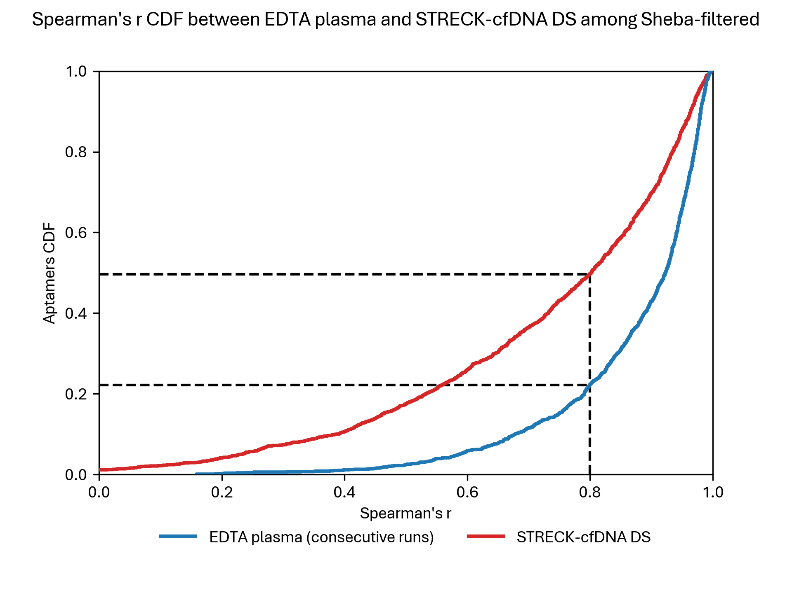
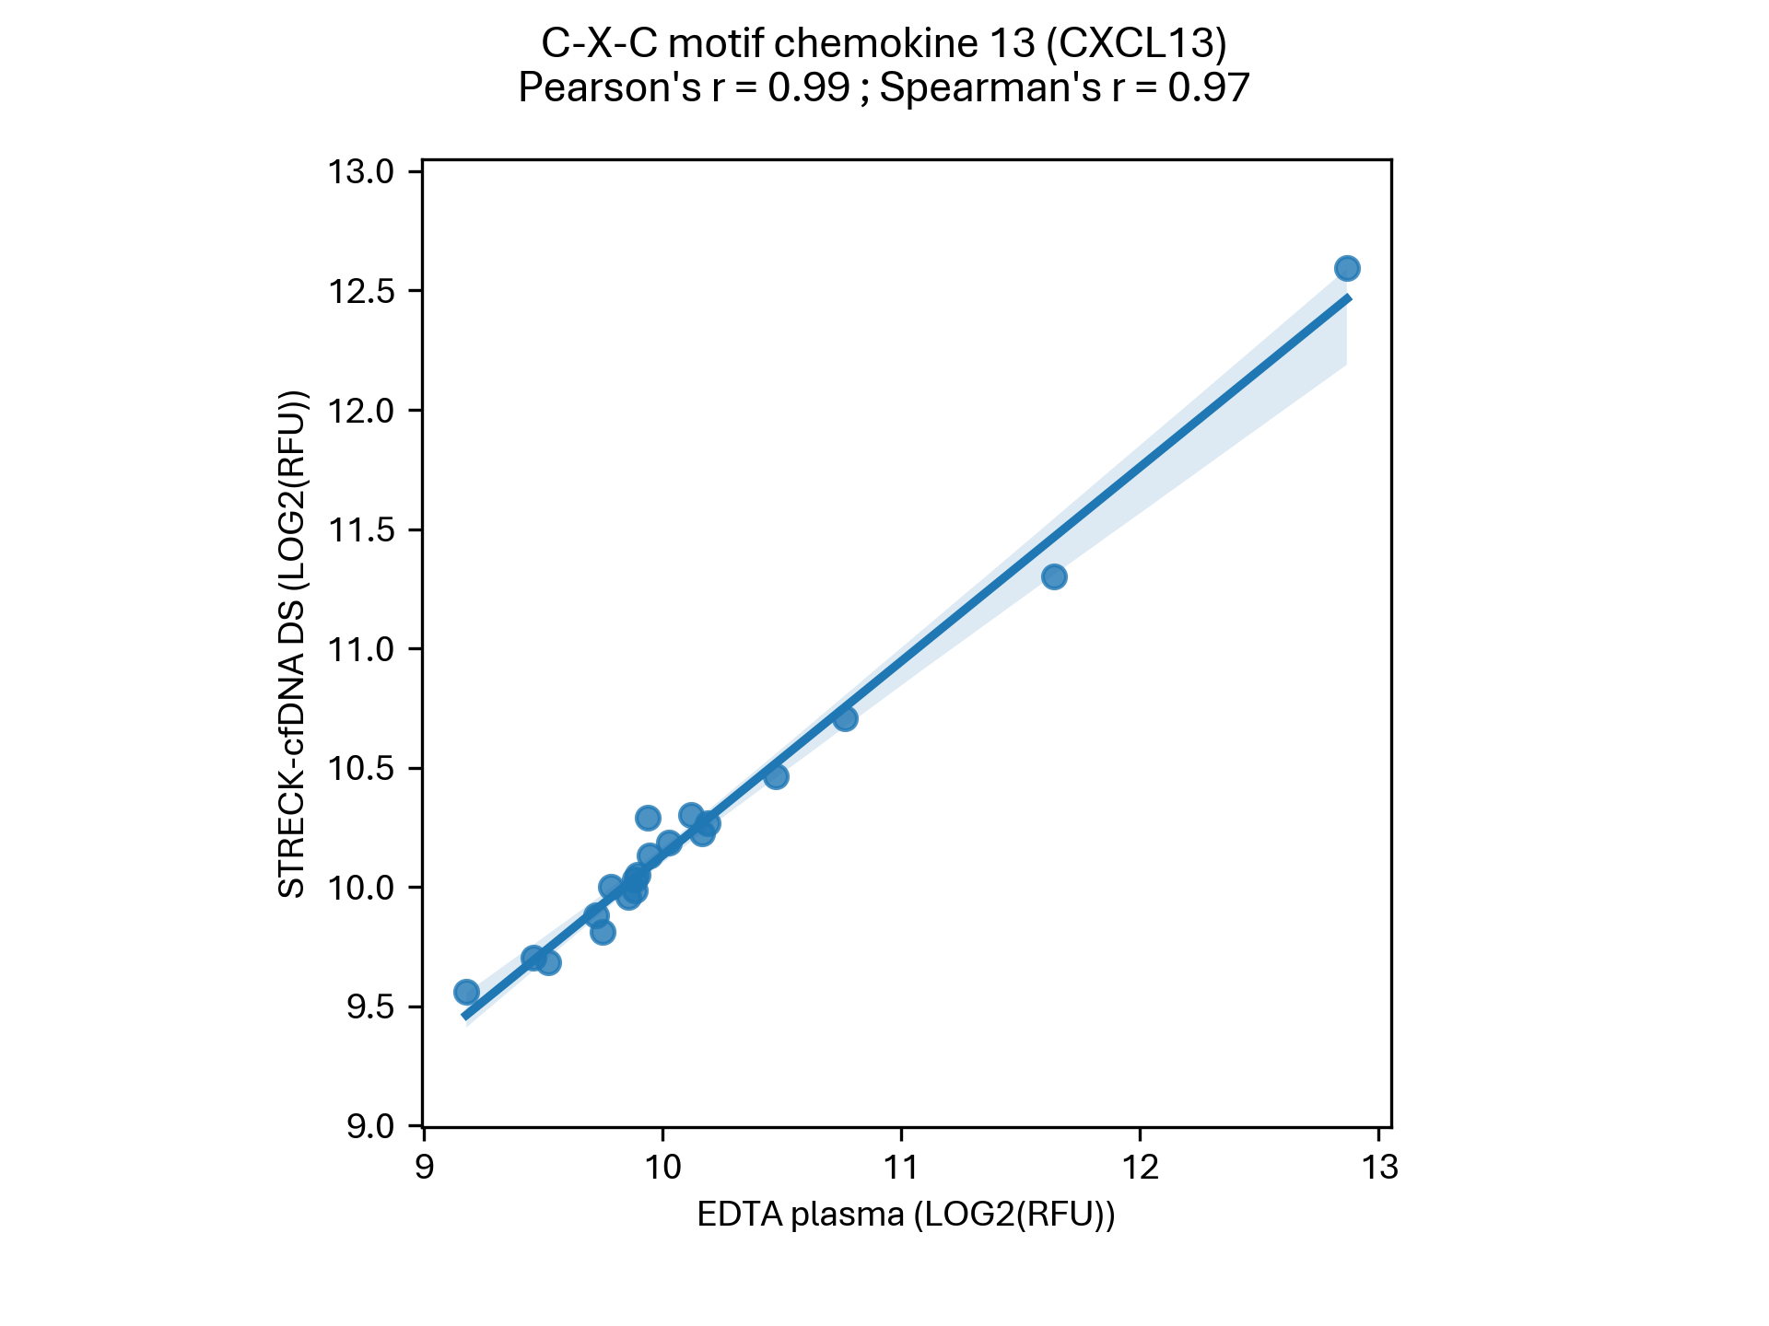
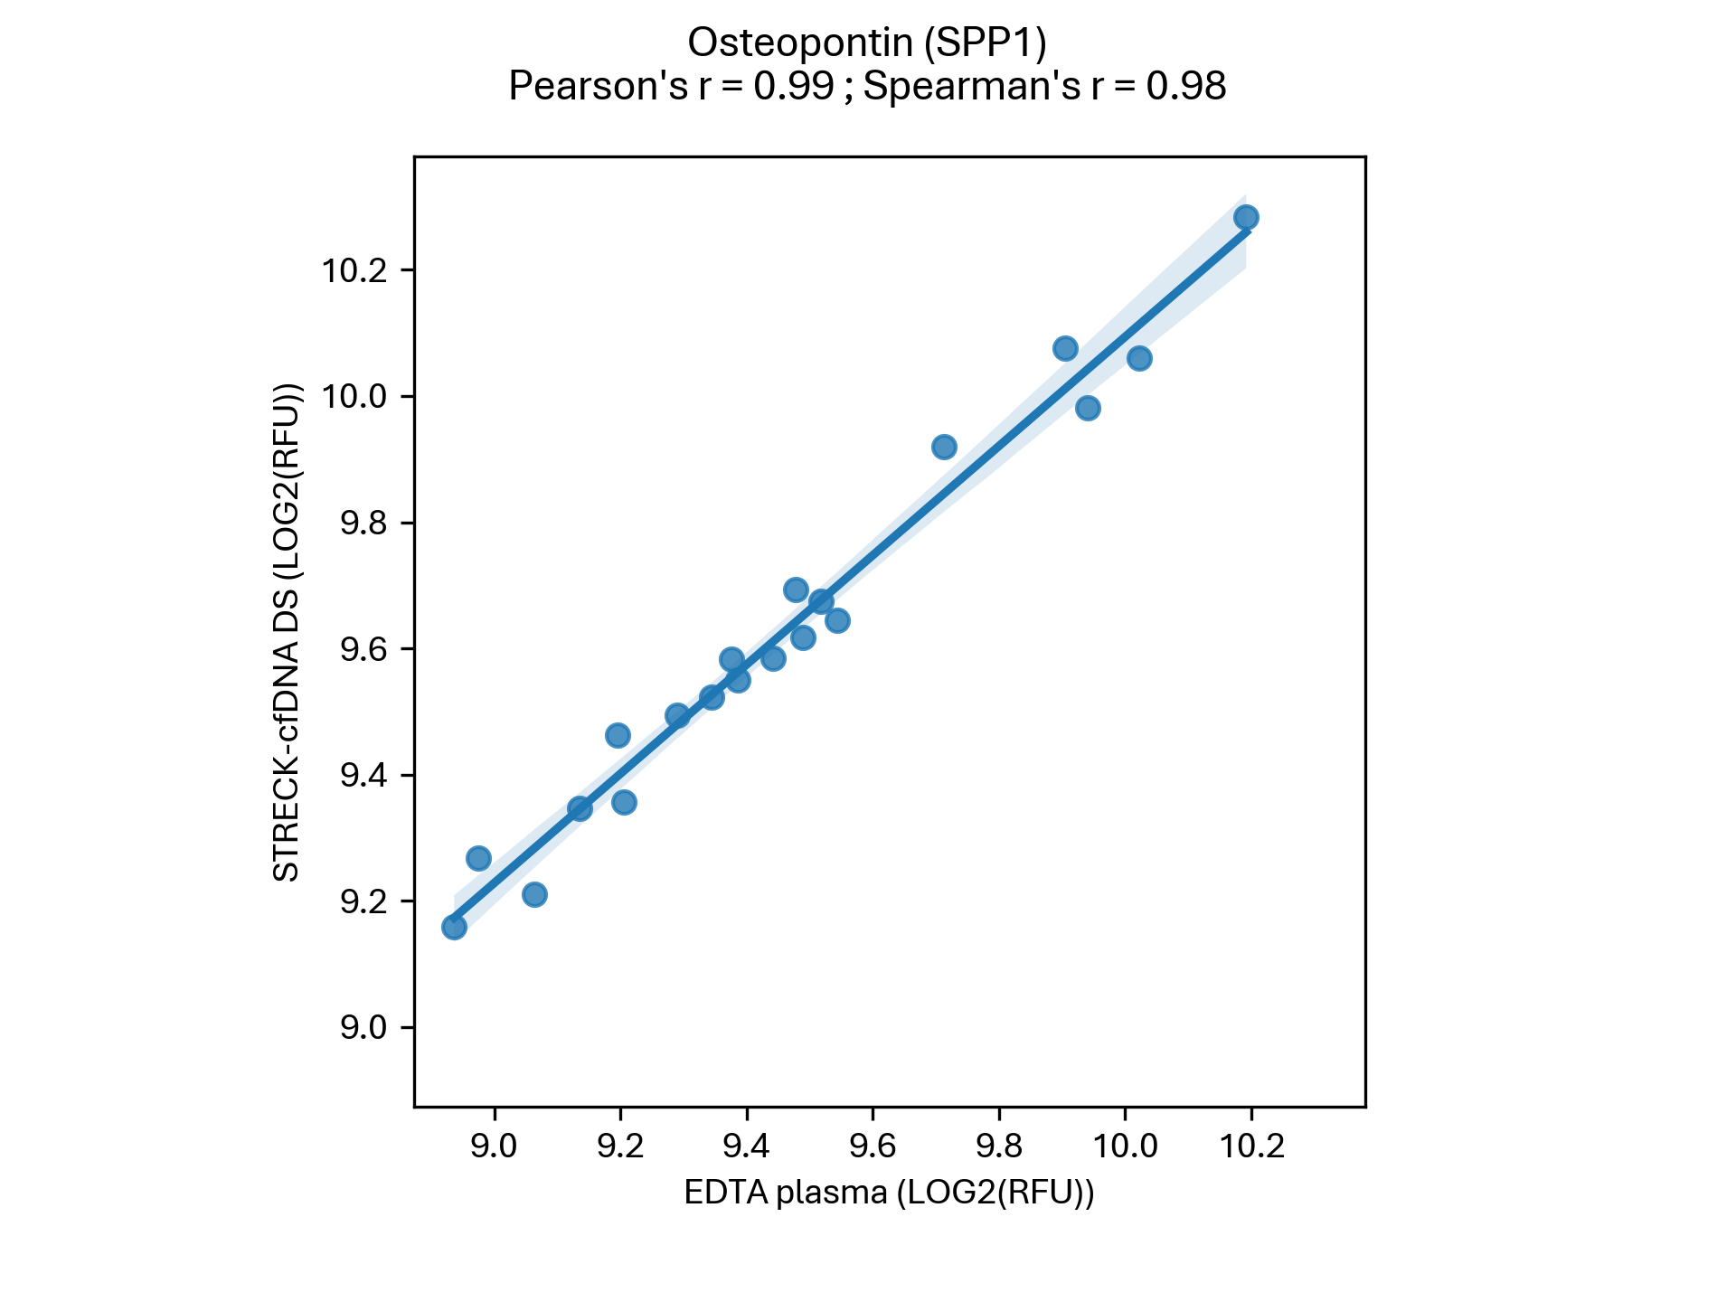
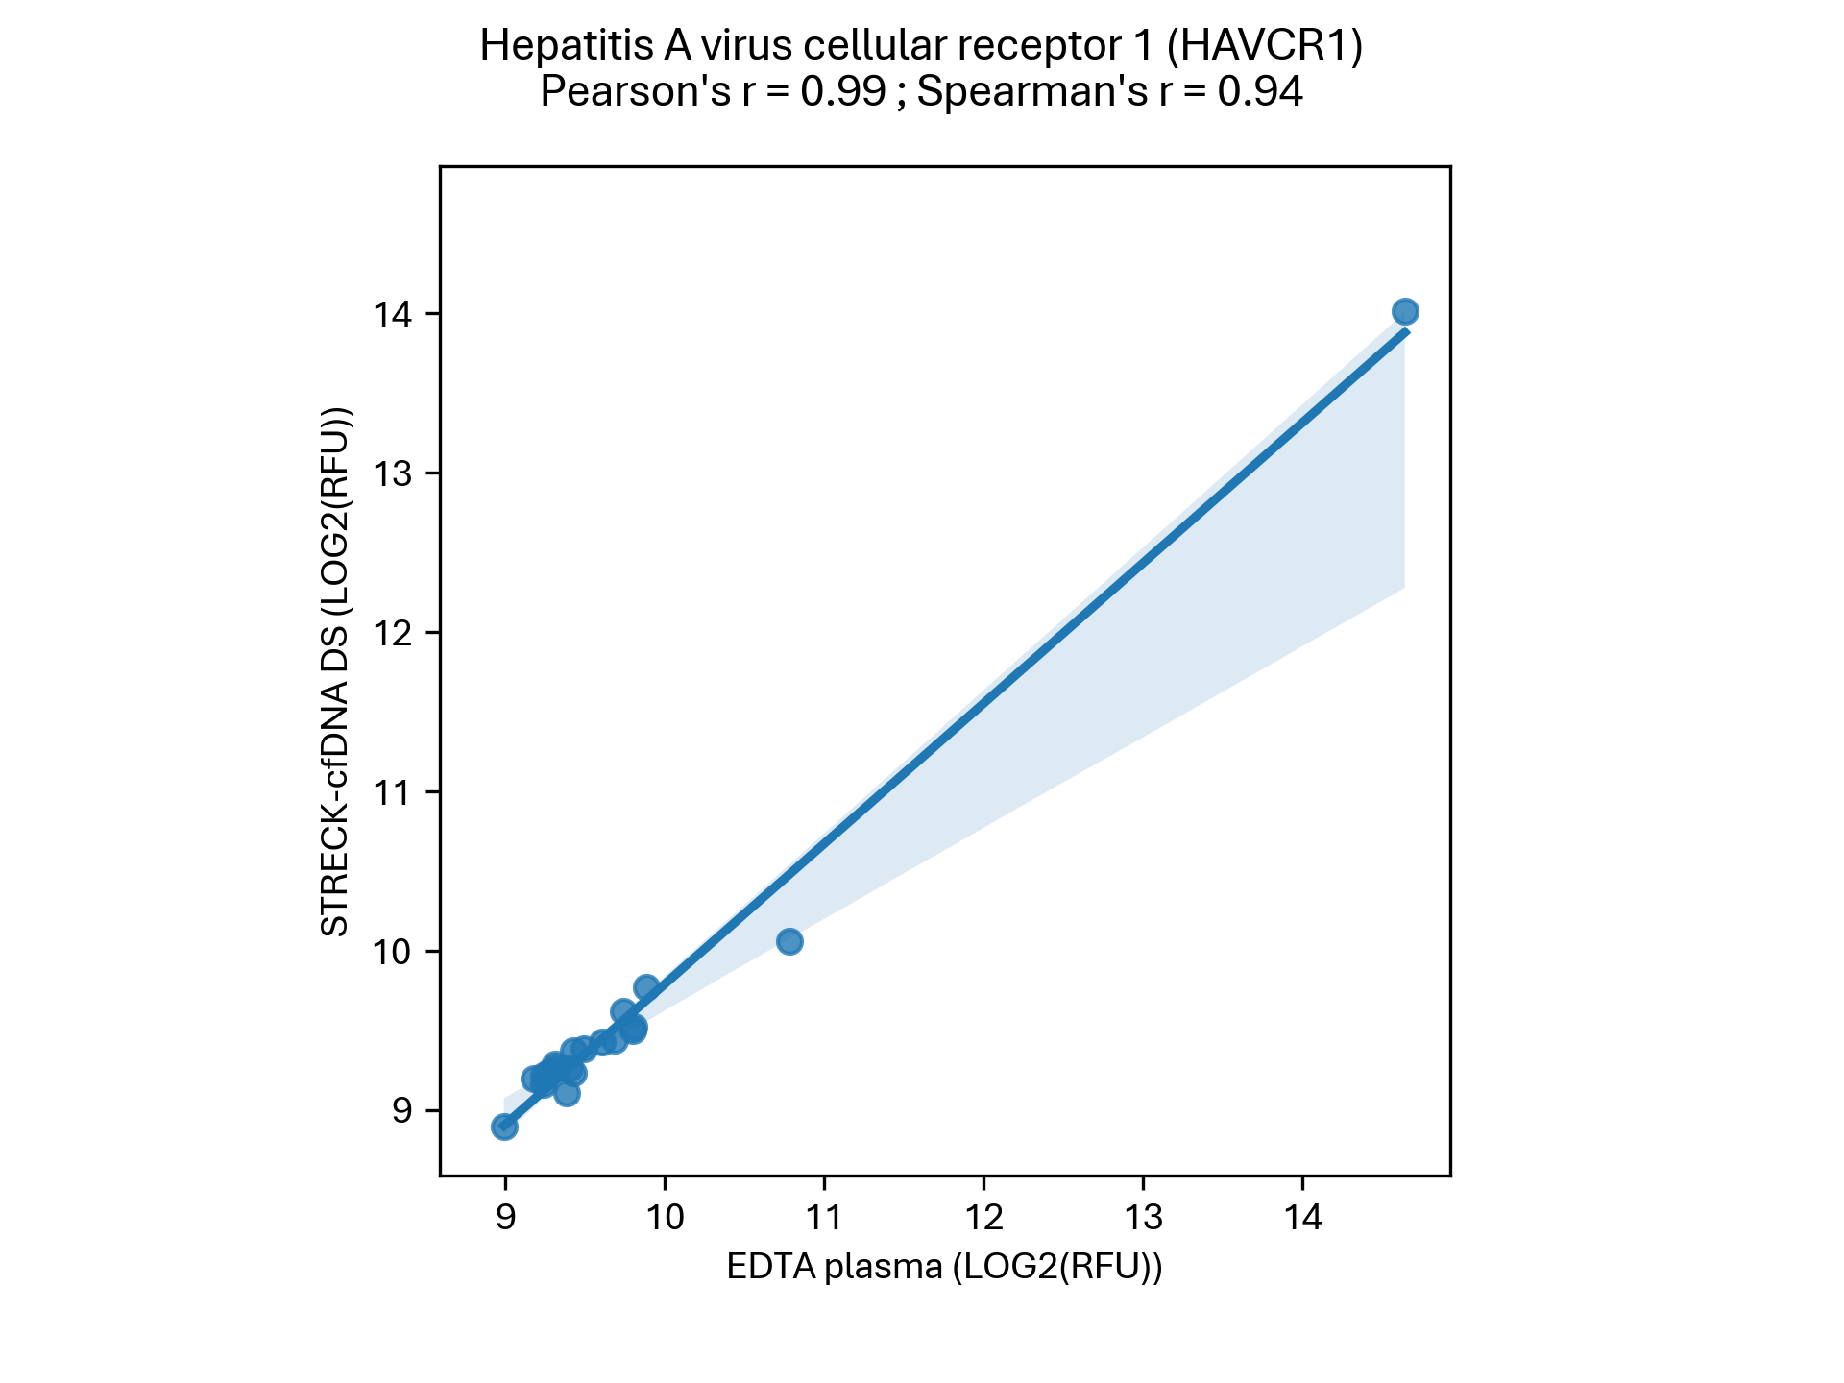
Streck cfDNA compared with EDTA consecutive runs

Slide 7
Spearman Correlation

Slide 8
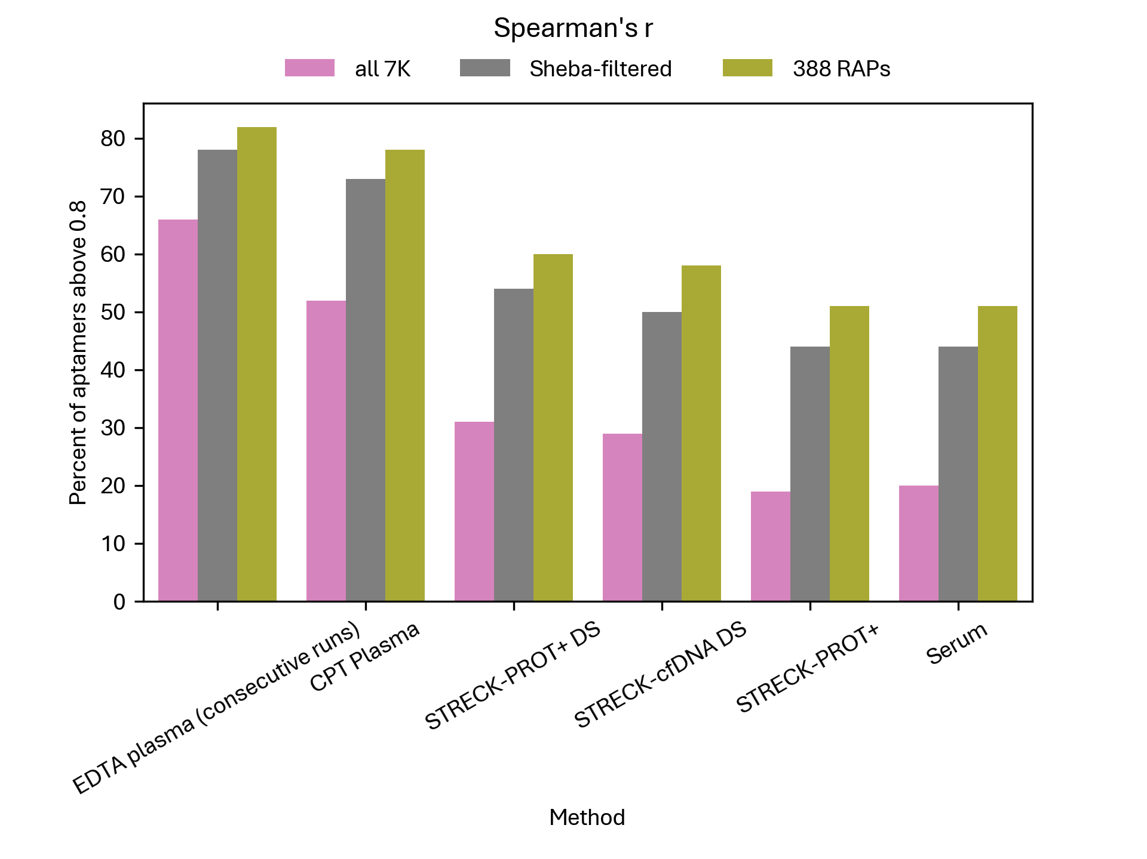
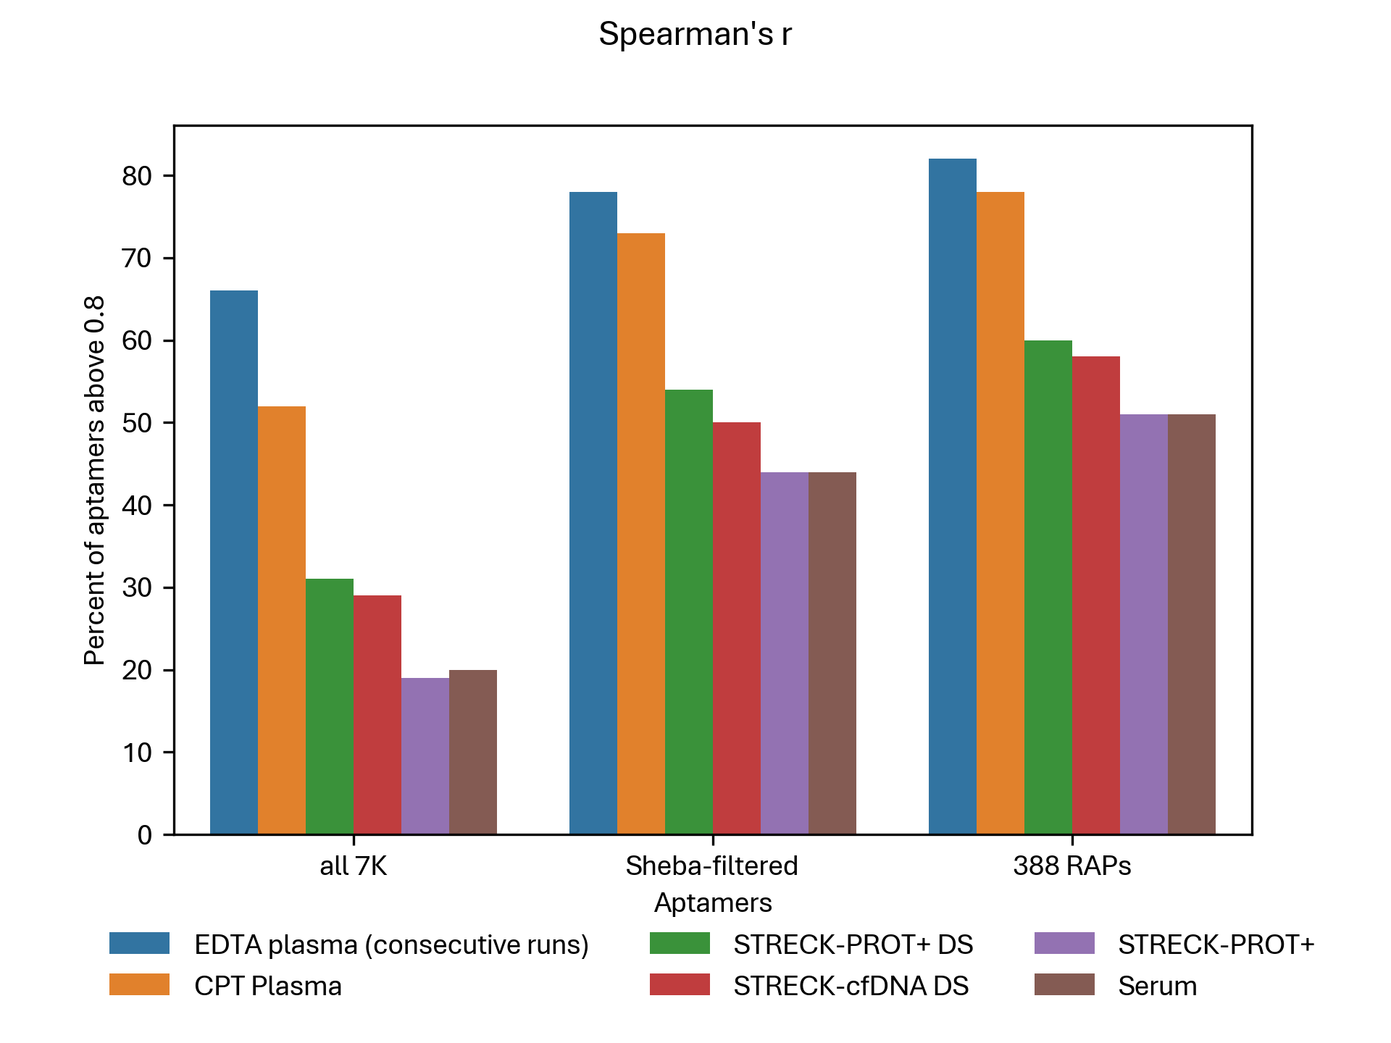
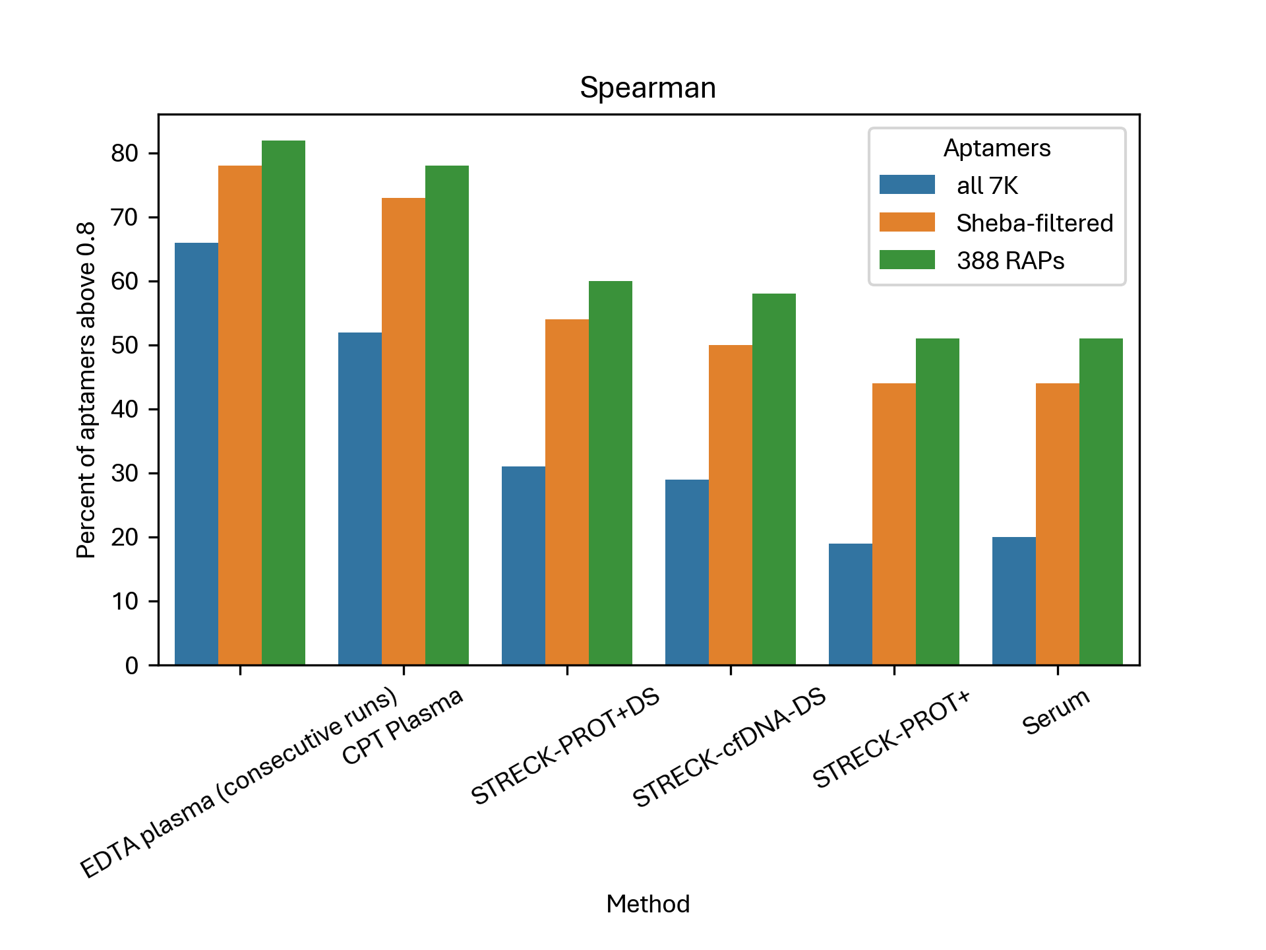
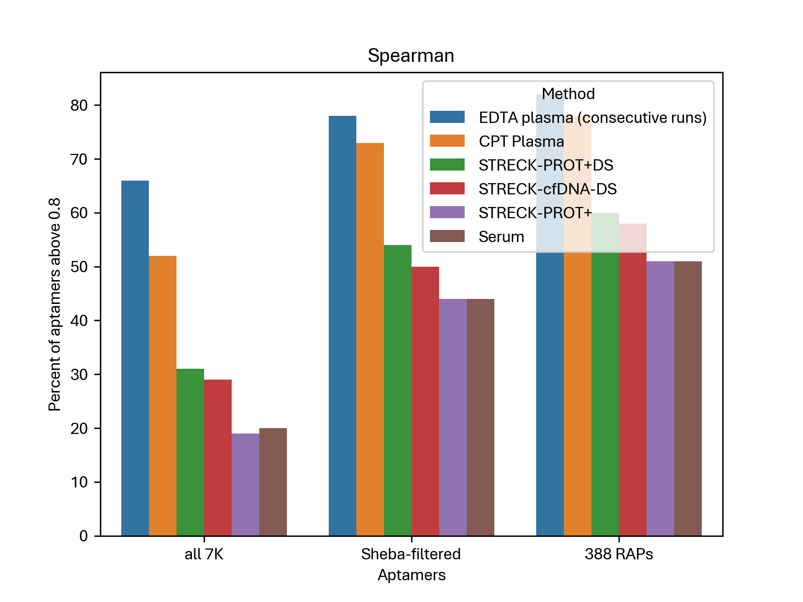
Spearman correlation – Summary

Slide 9
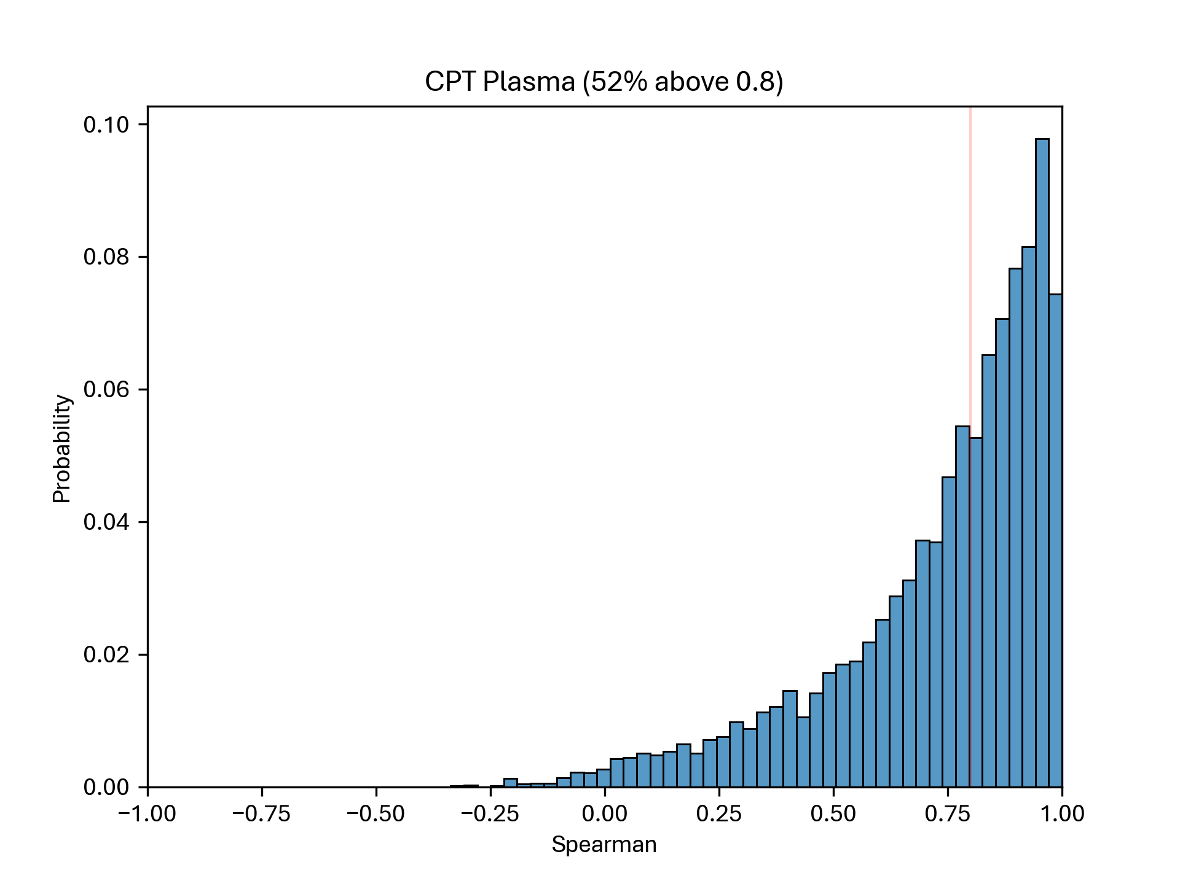
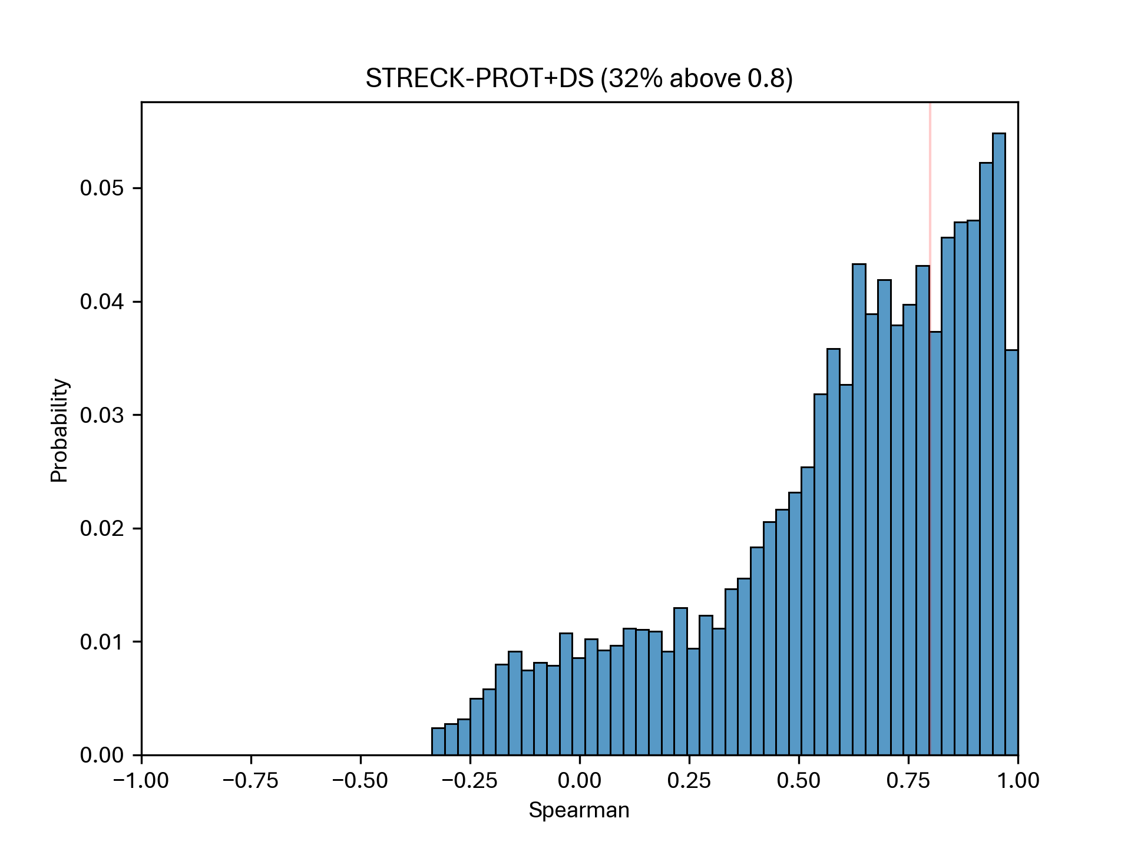
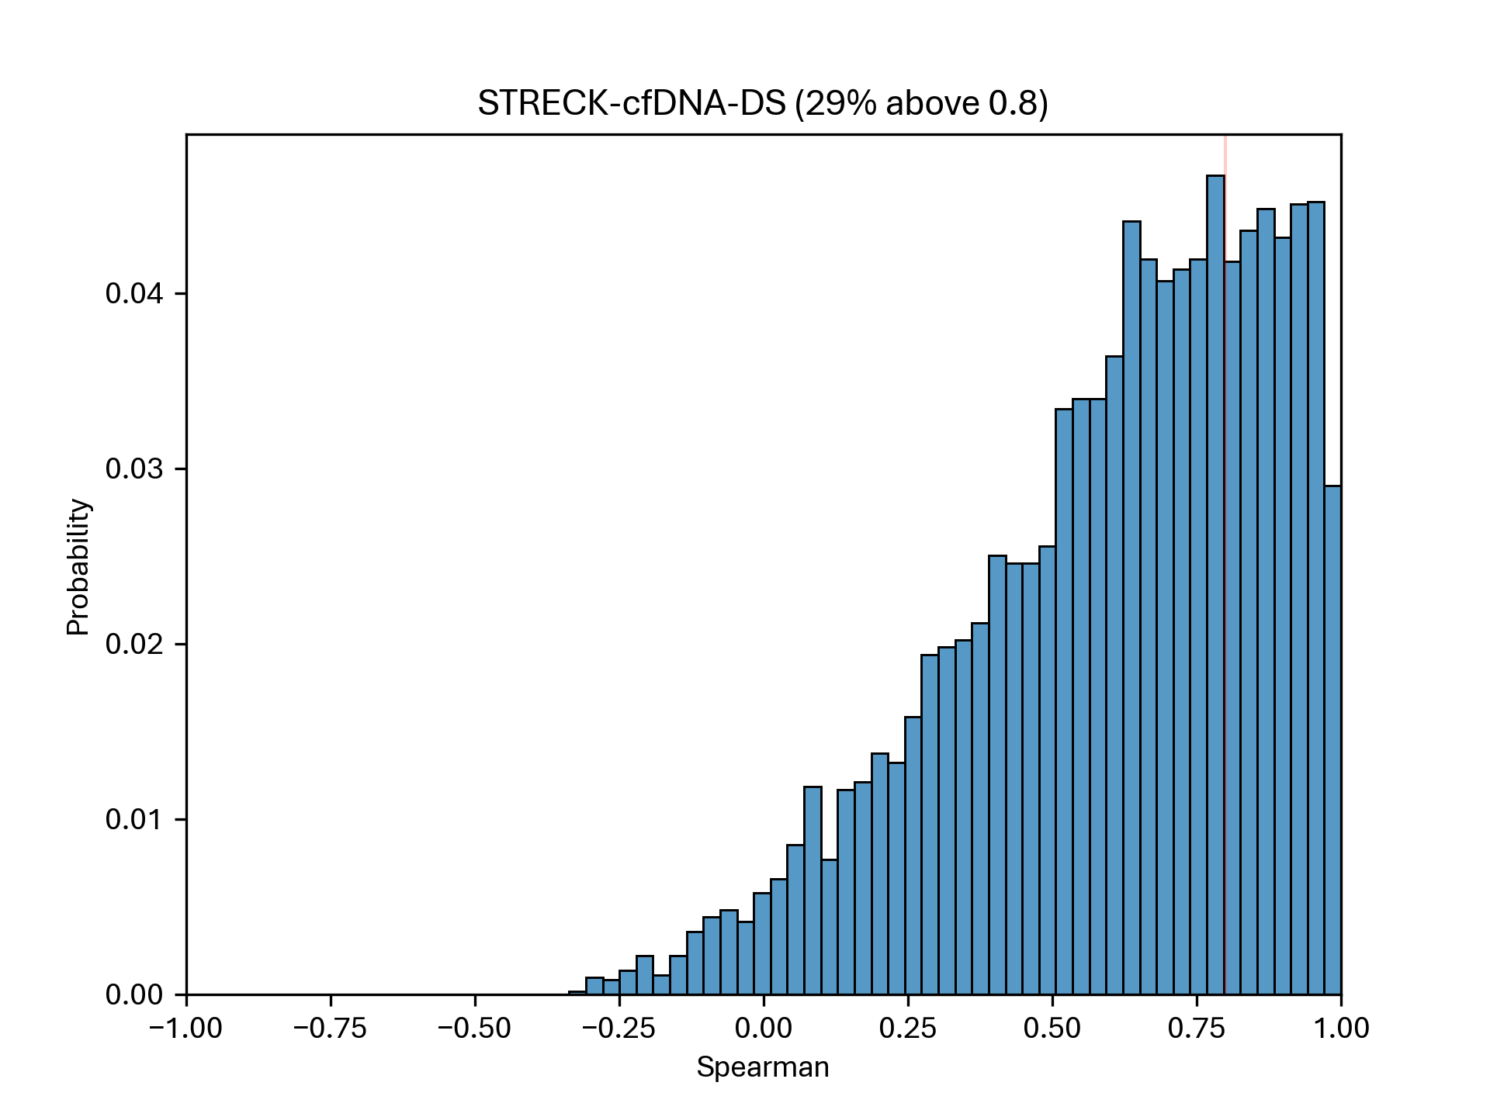
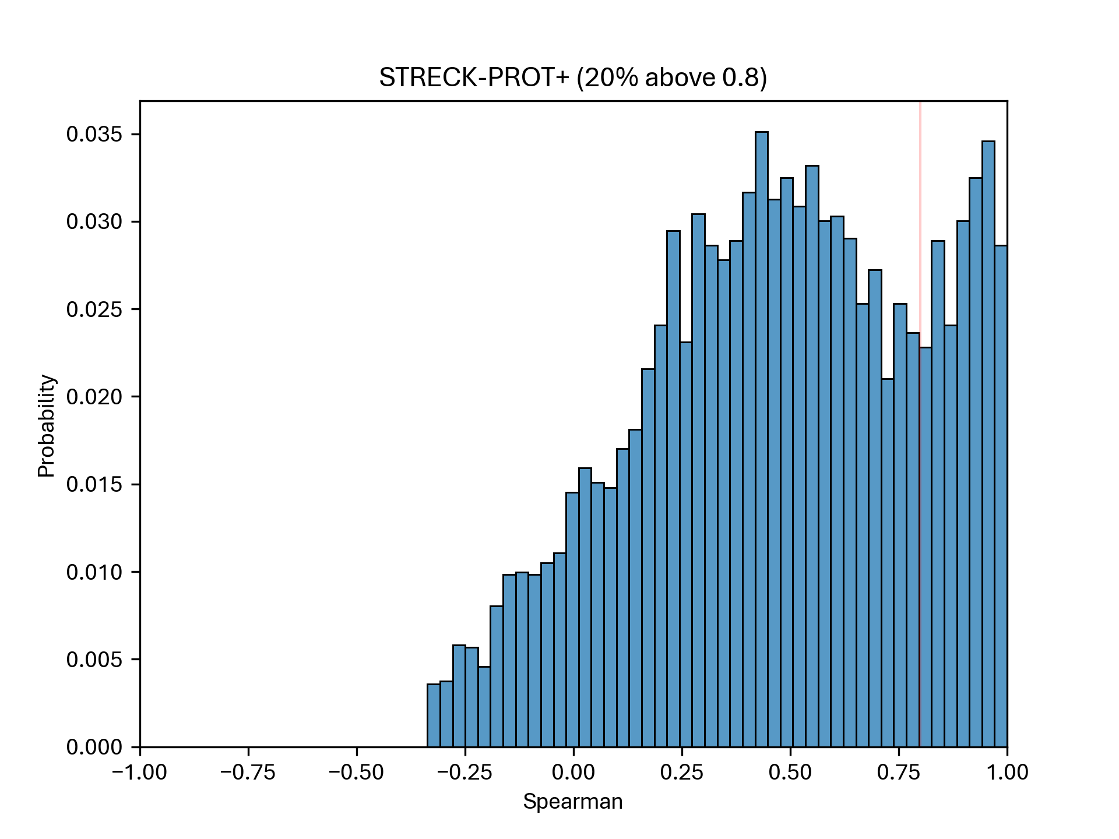
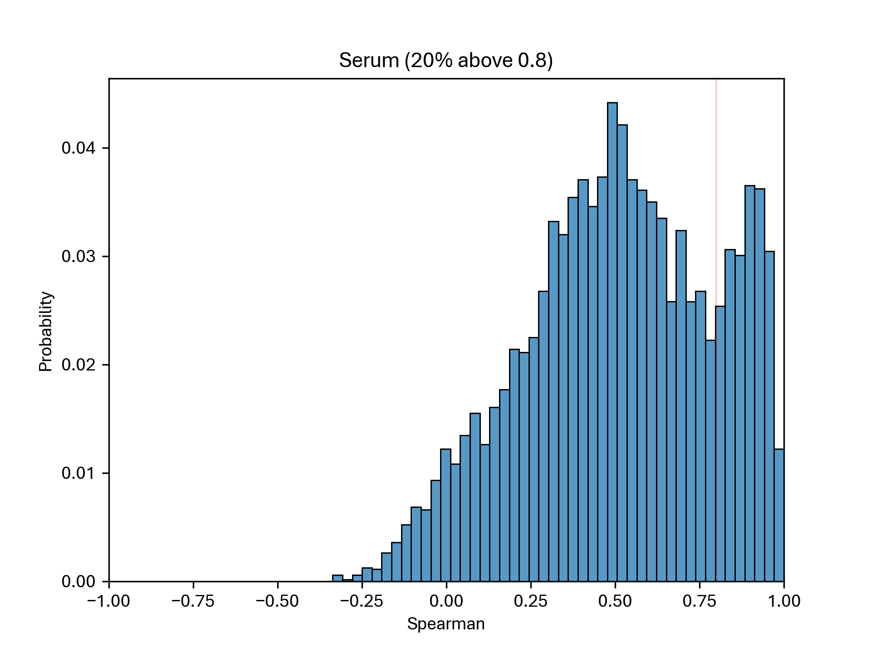
Spearman correlation – All 7K

Slide 10
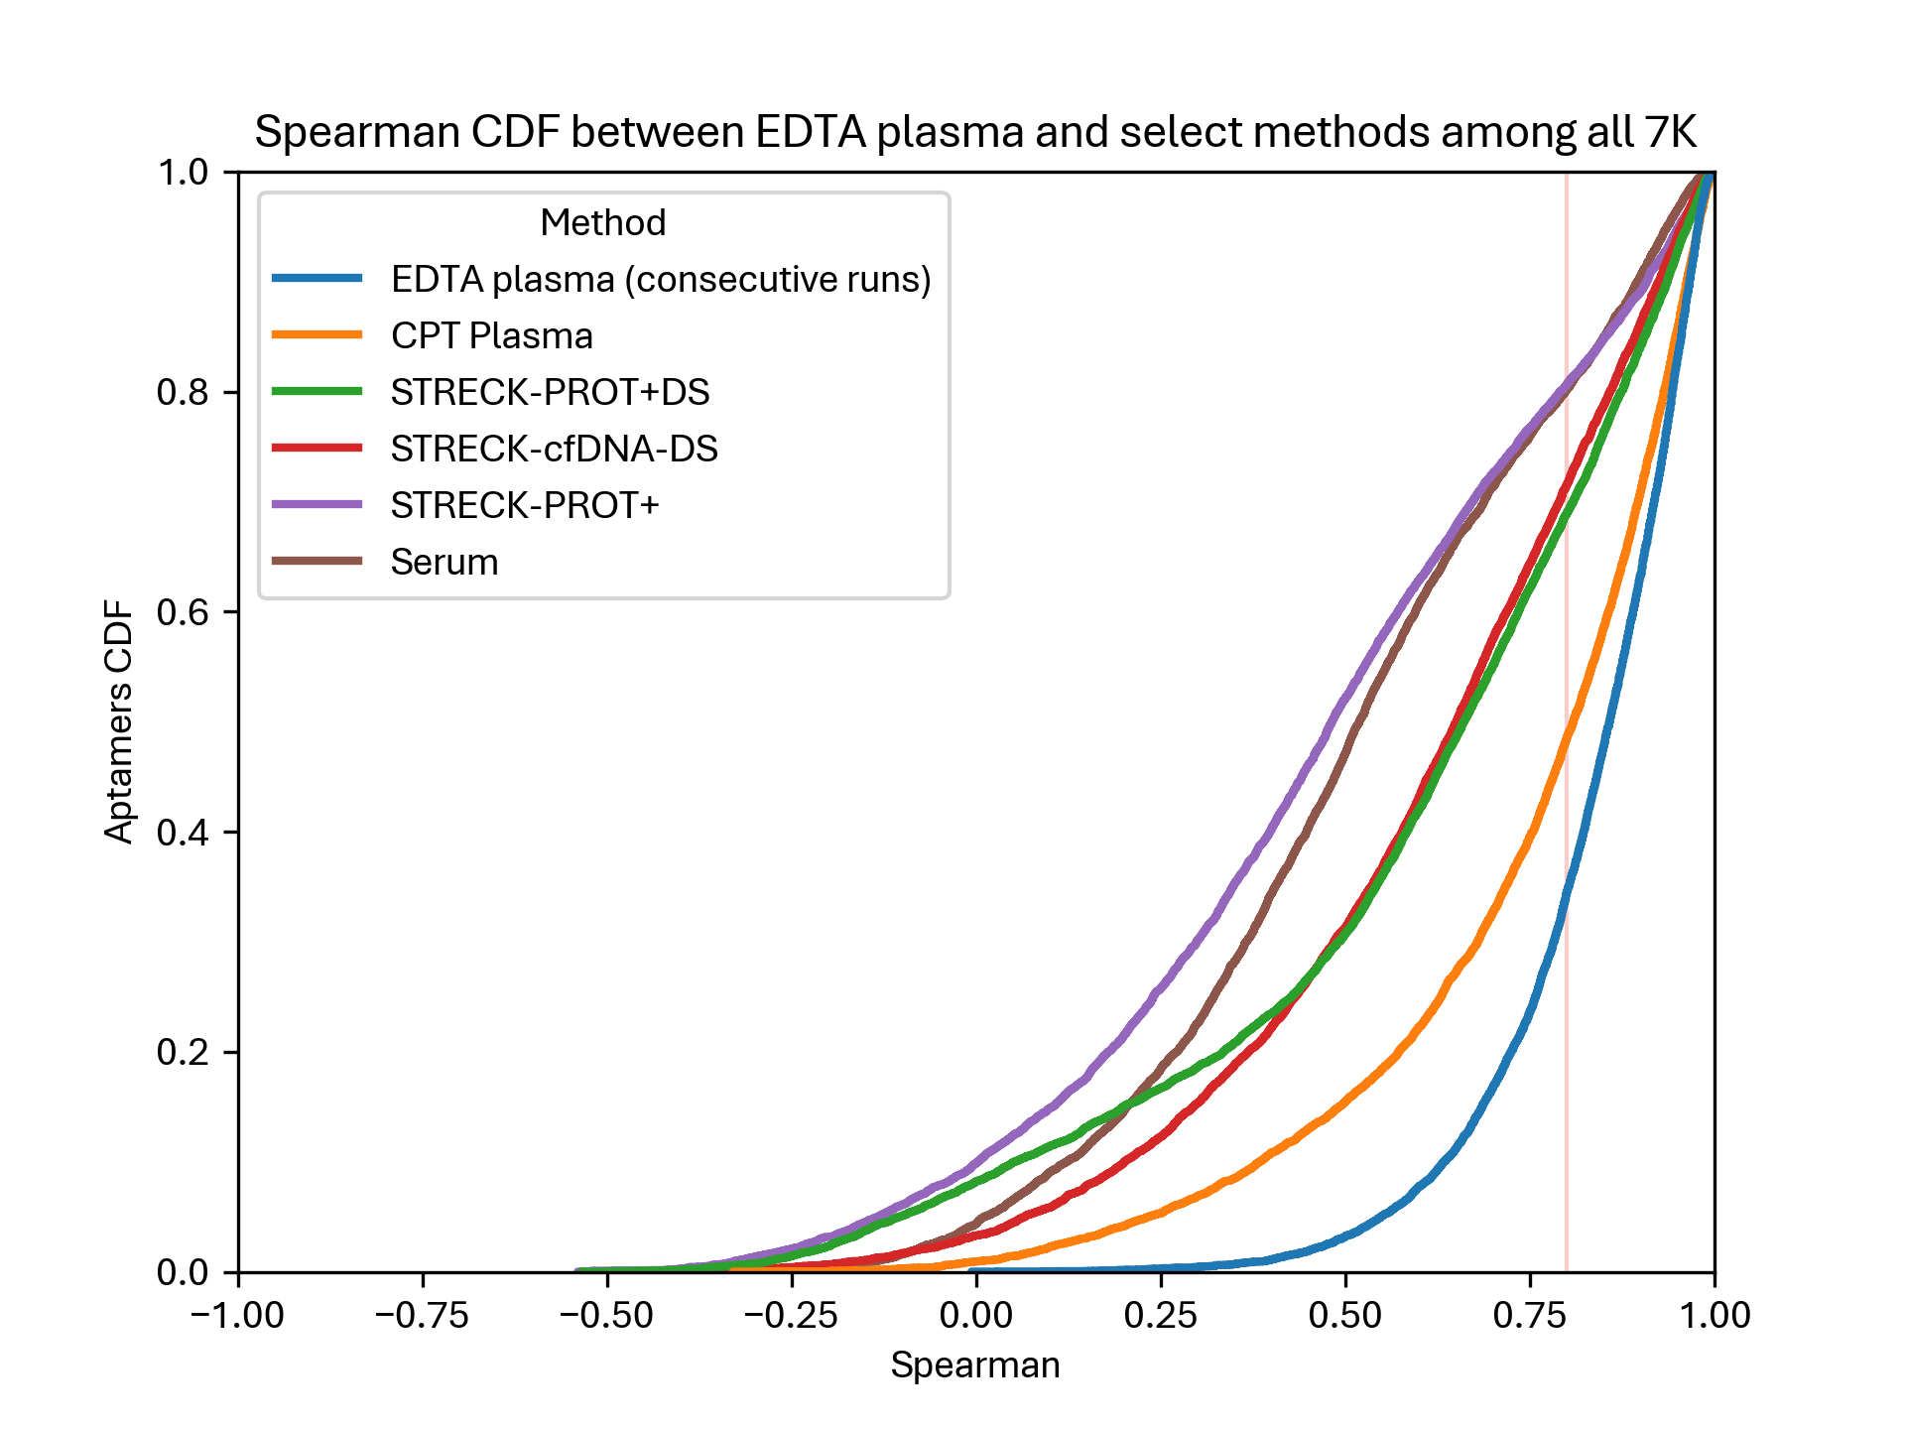
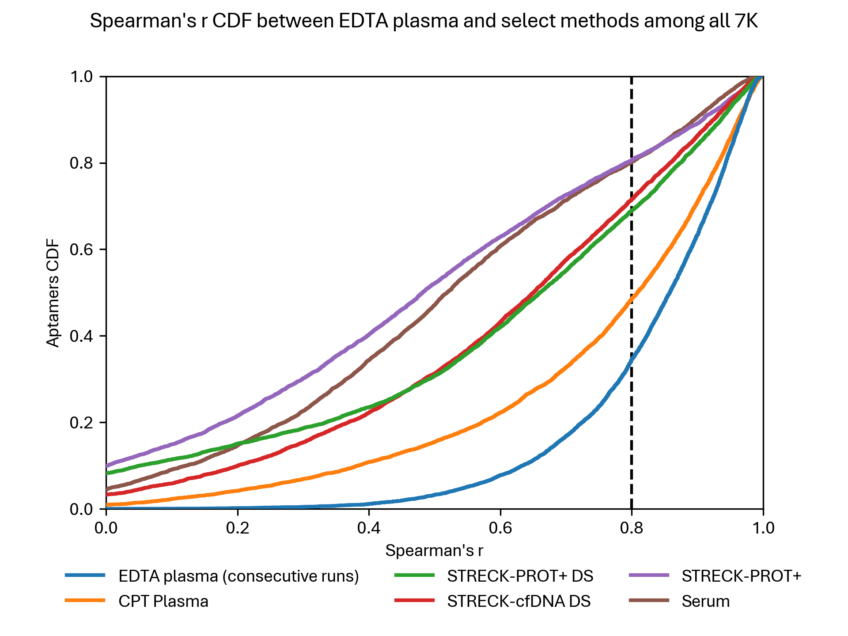
Spearman correlation – All 7K

Slide 11
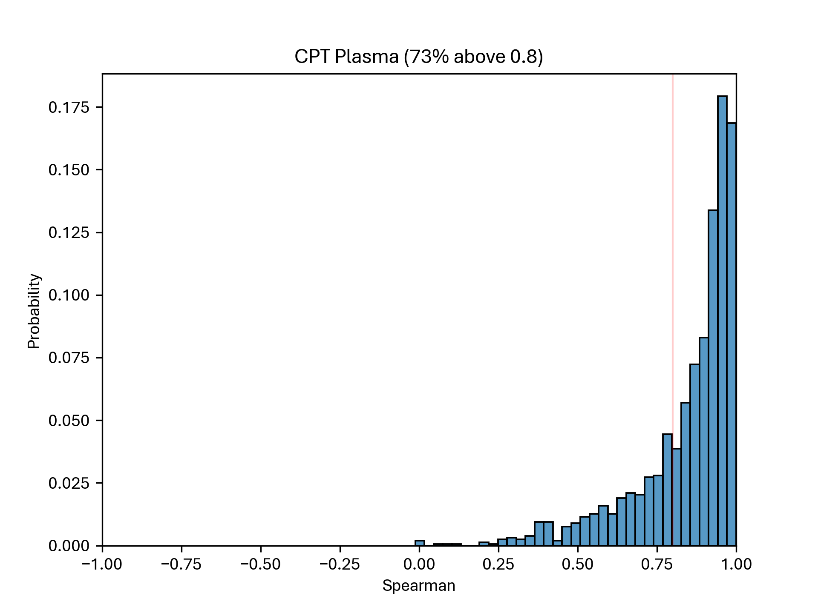
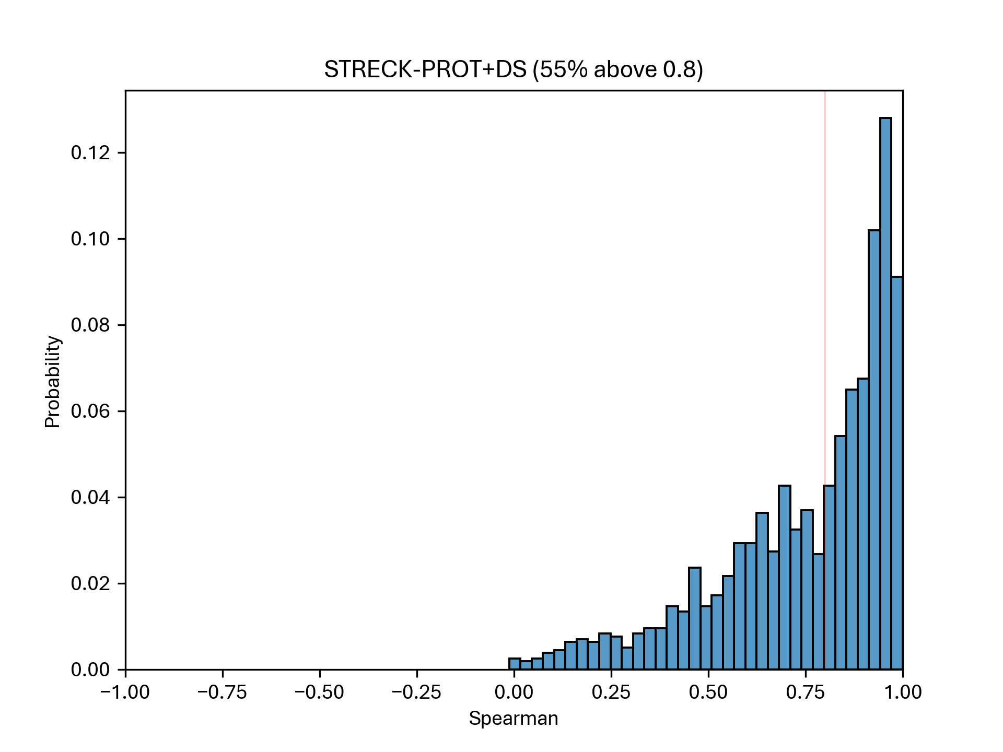
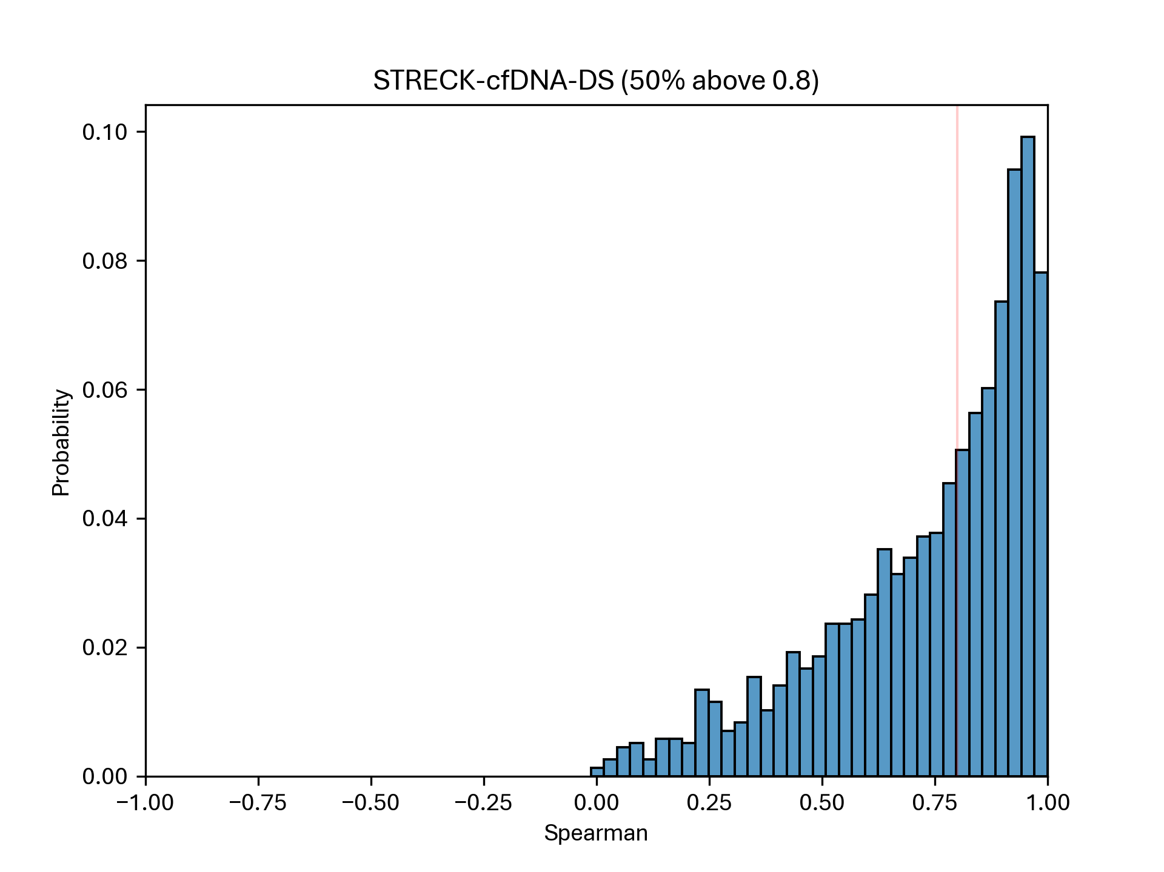
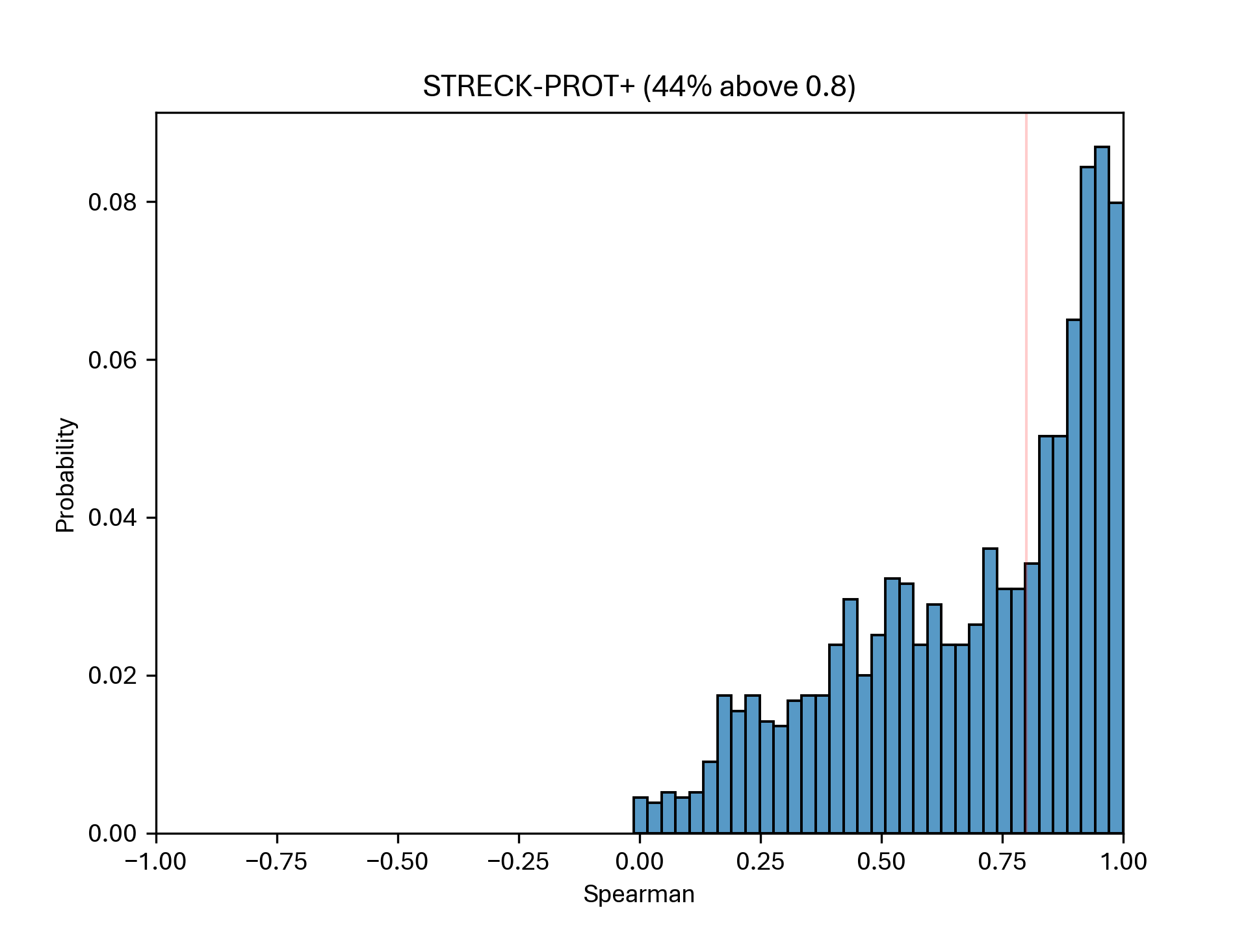
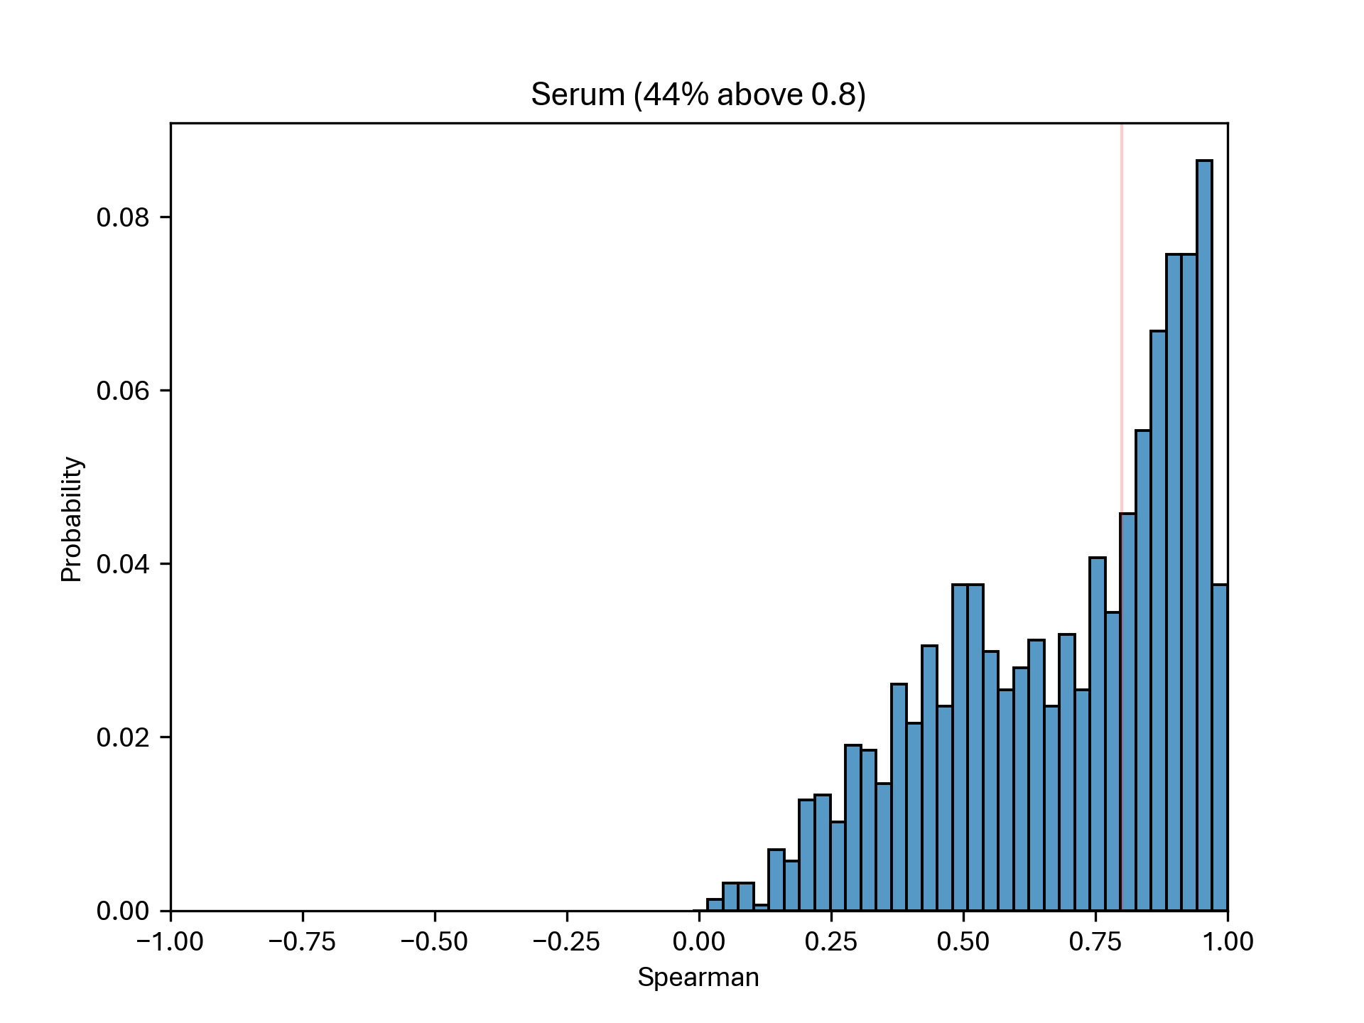
Spearman correlation – Sheba

Slide 12
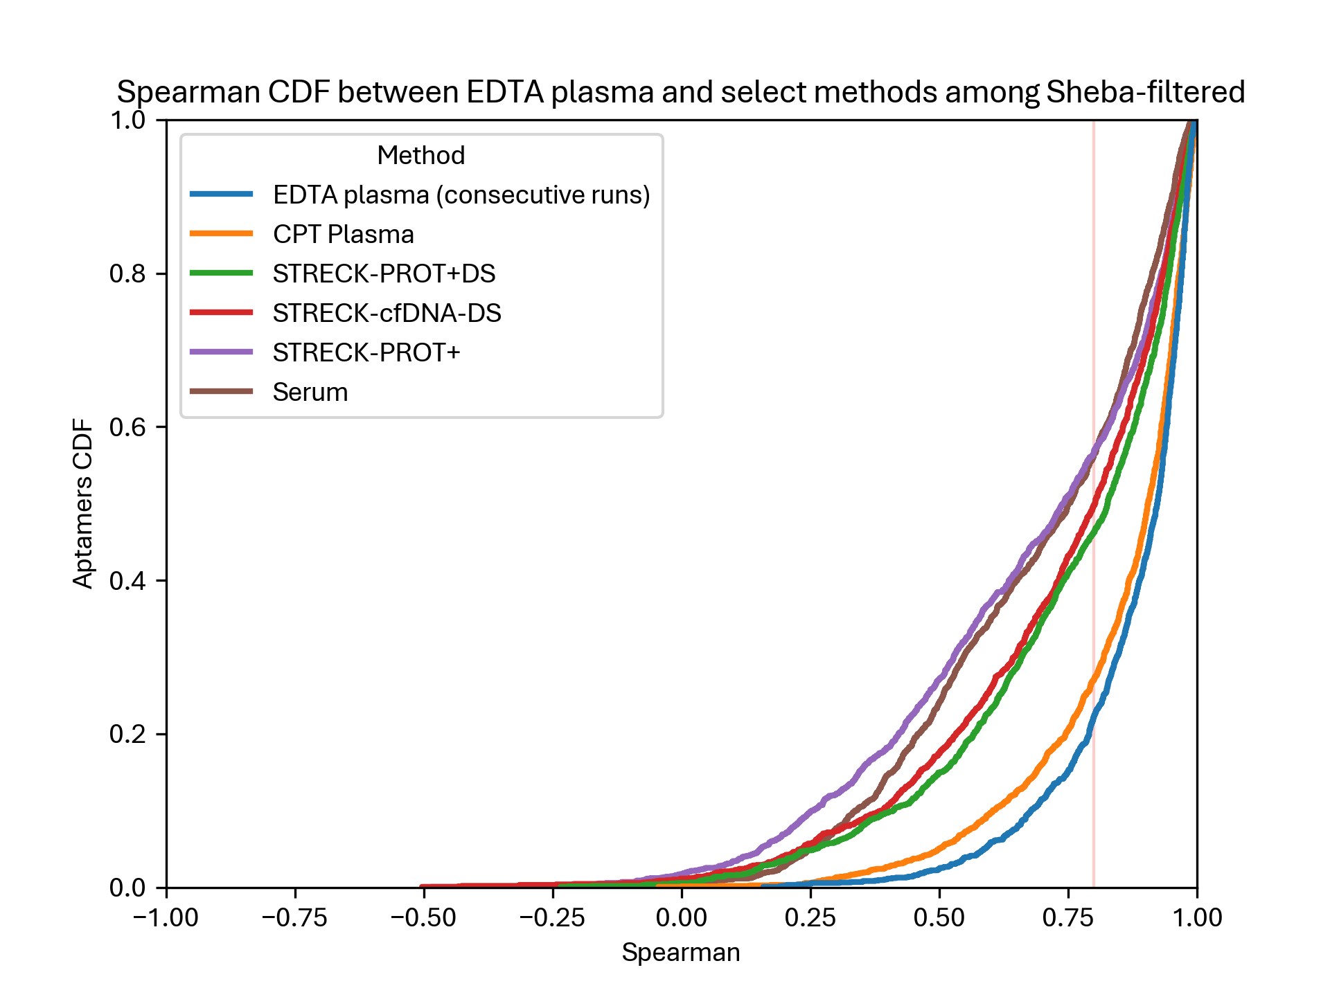
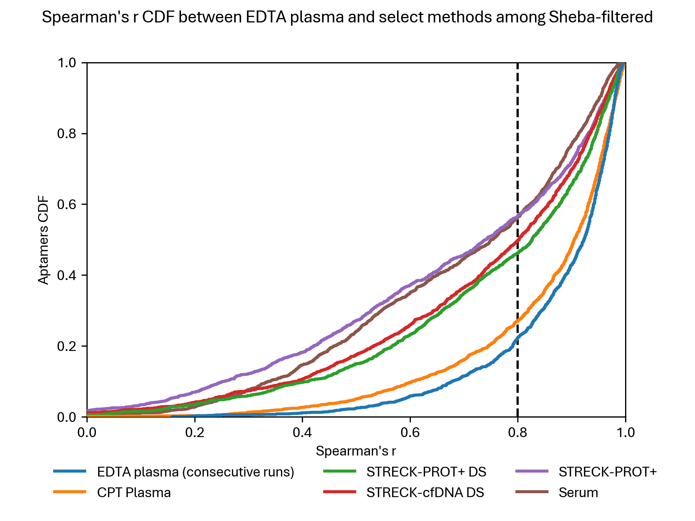
Spearman correlation – Sheba

Slide 13
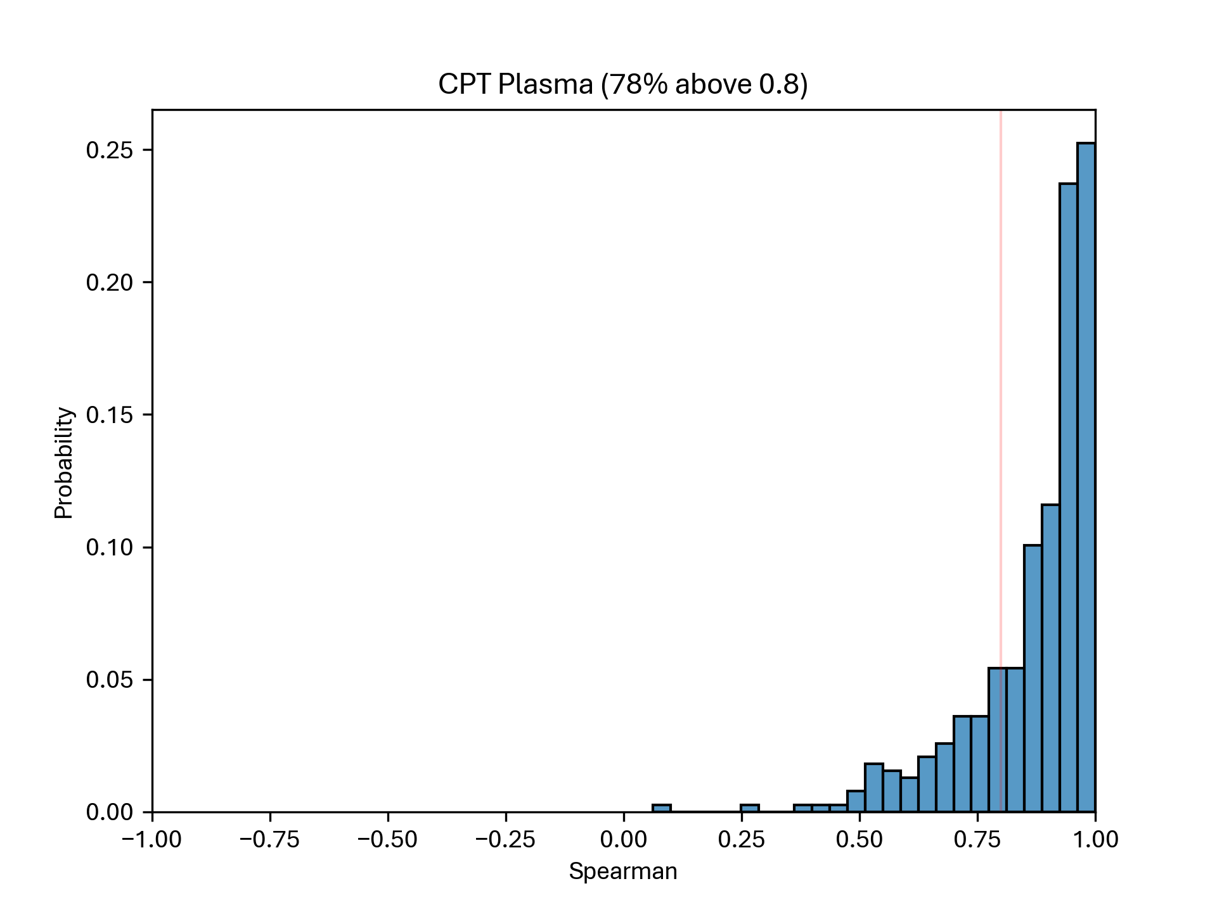
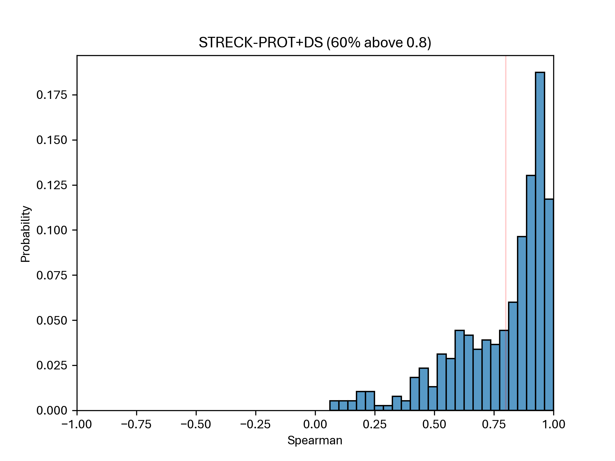
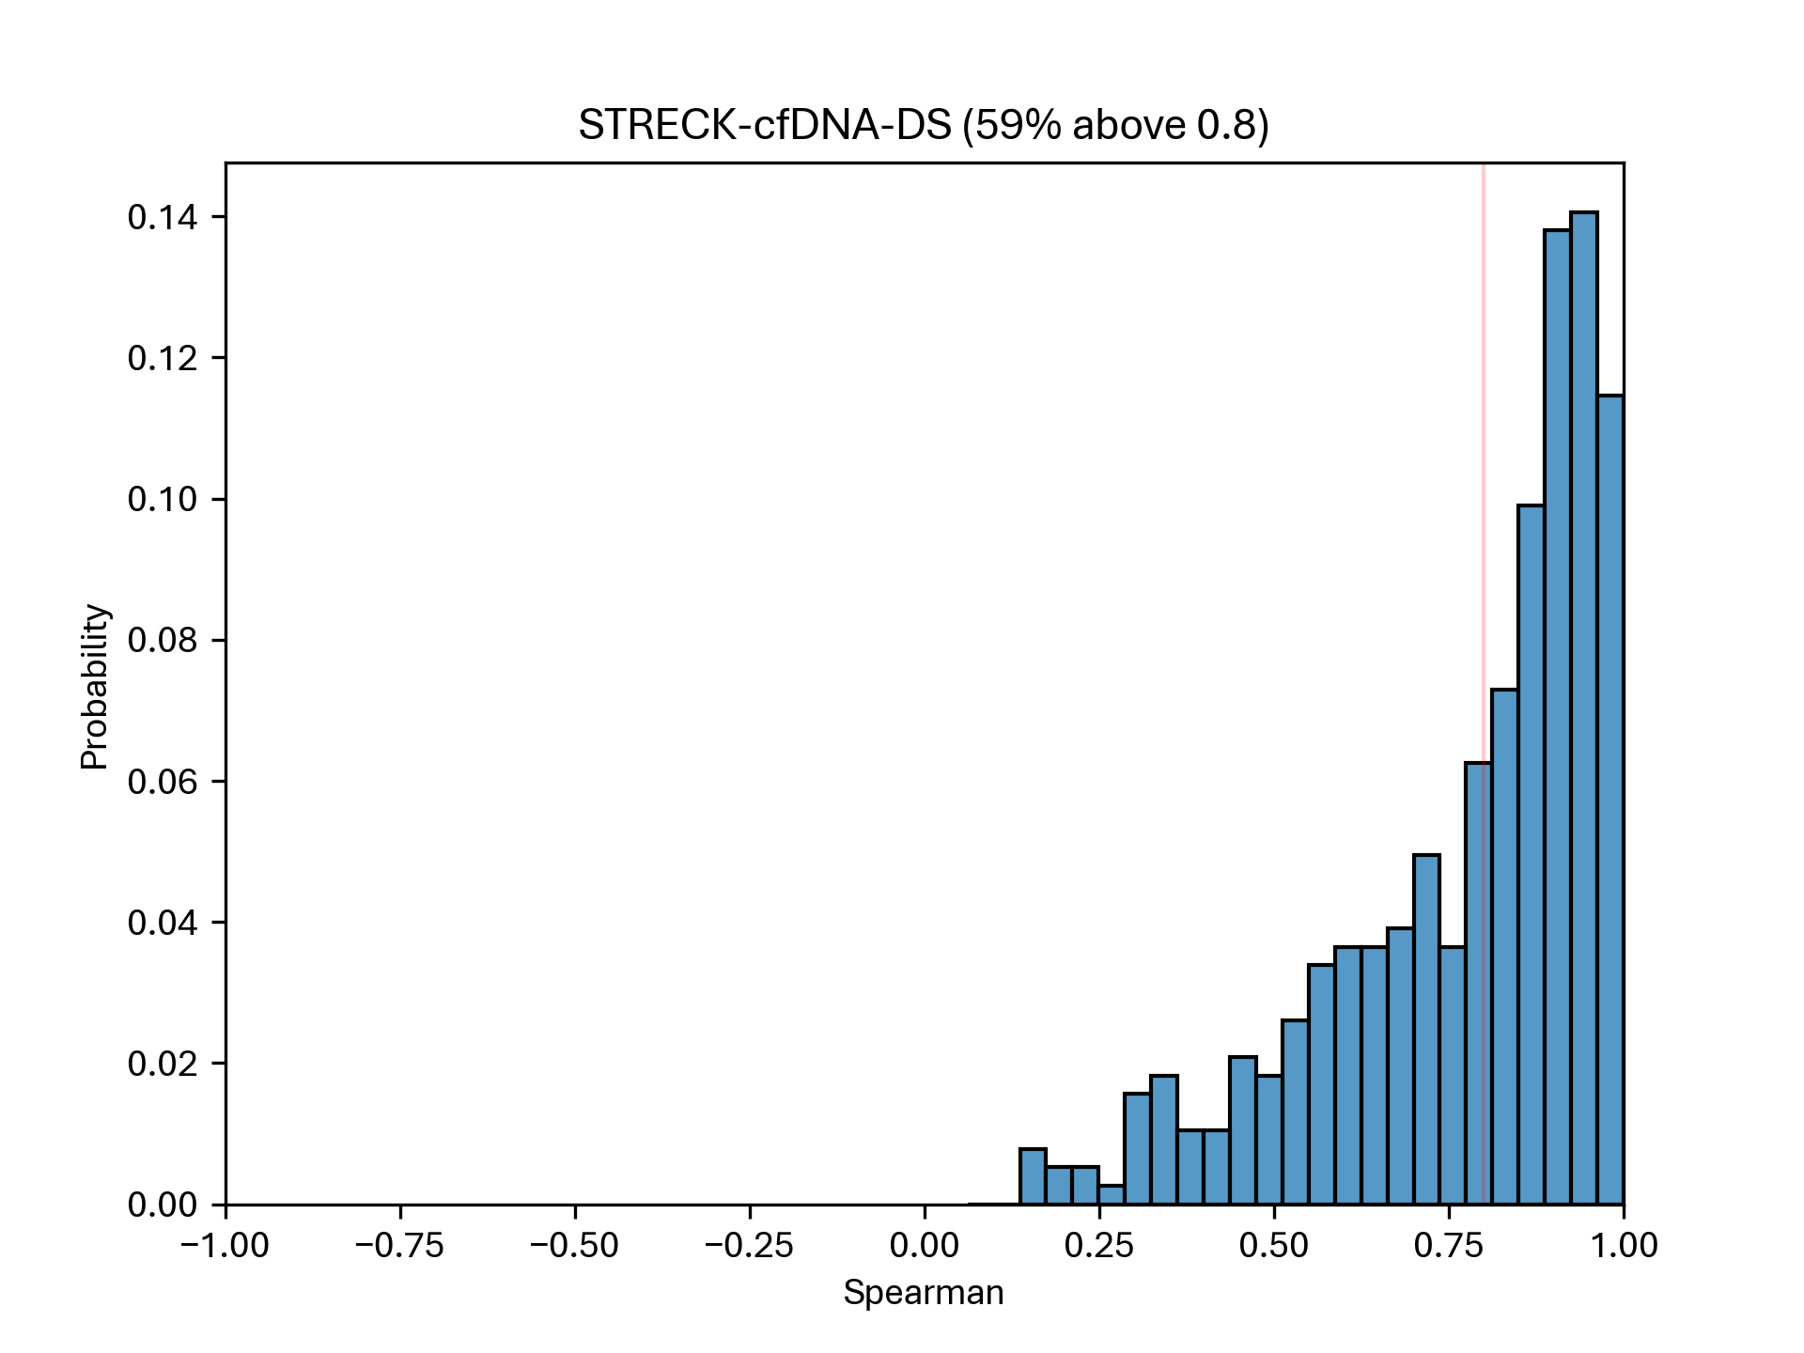
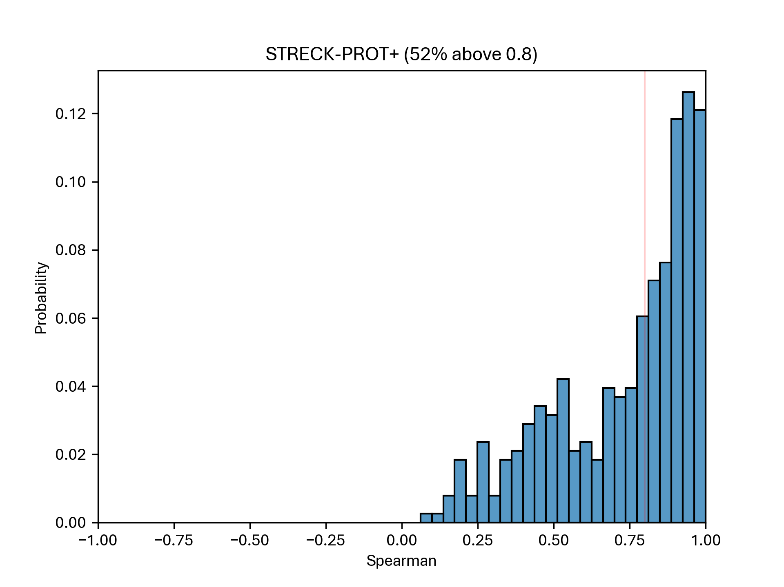
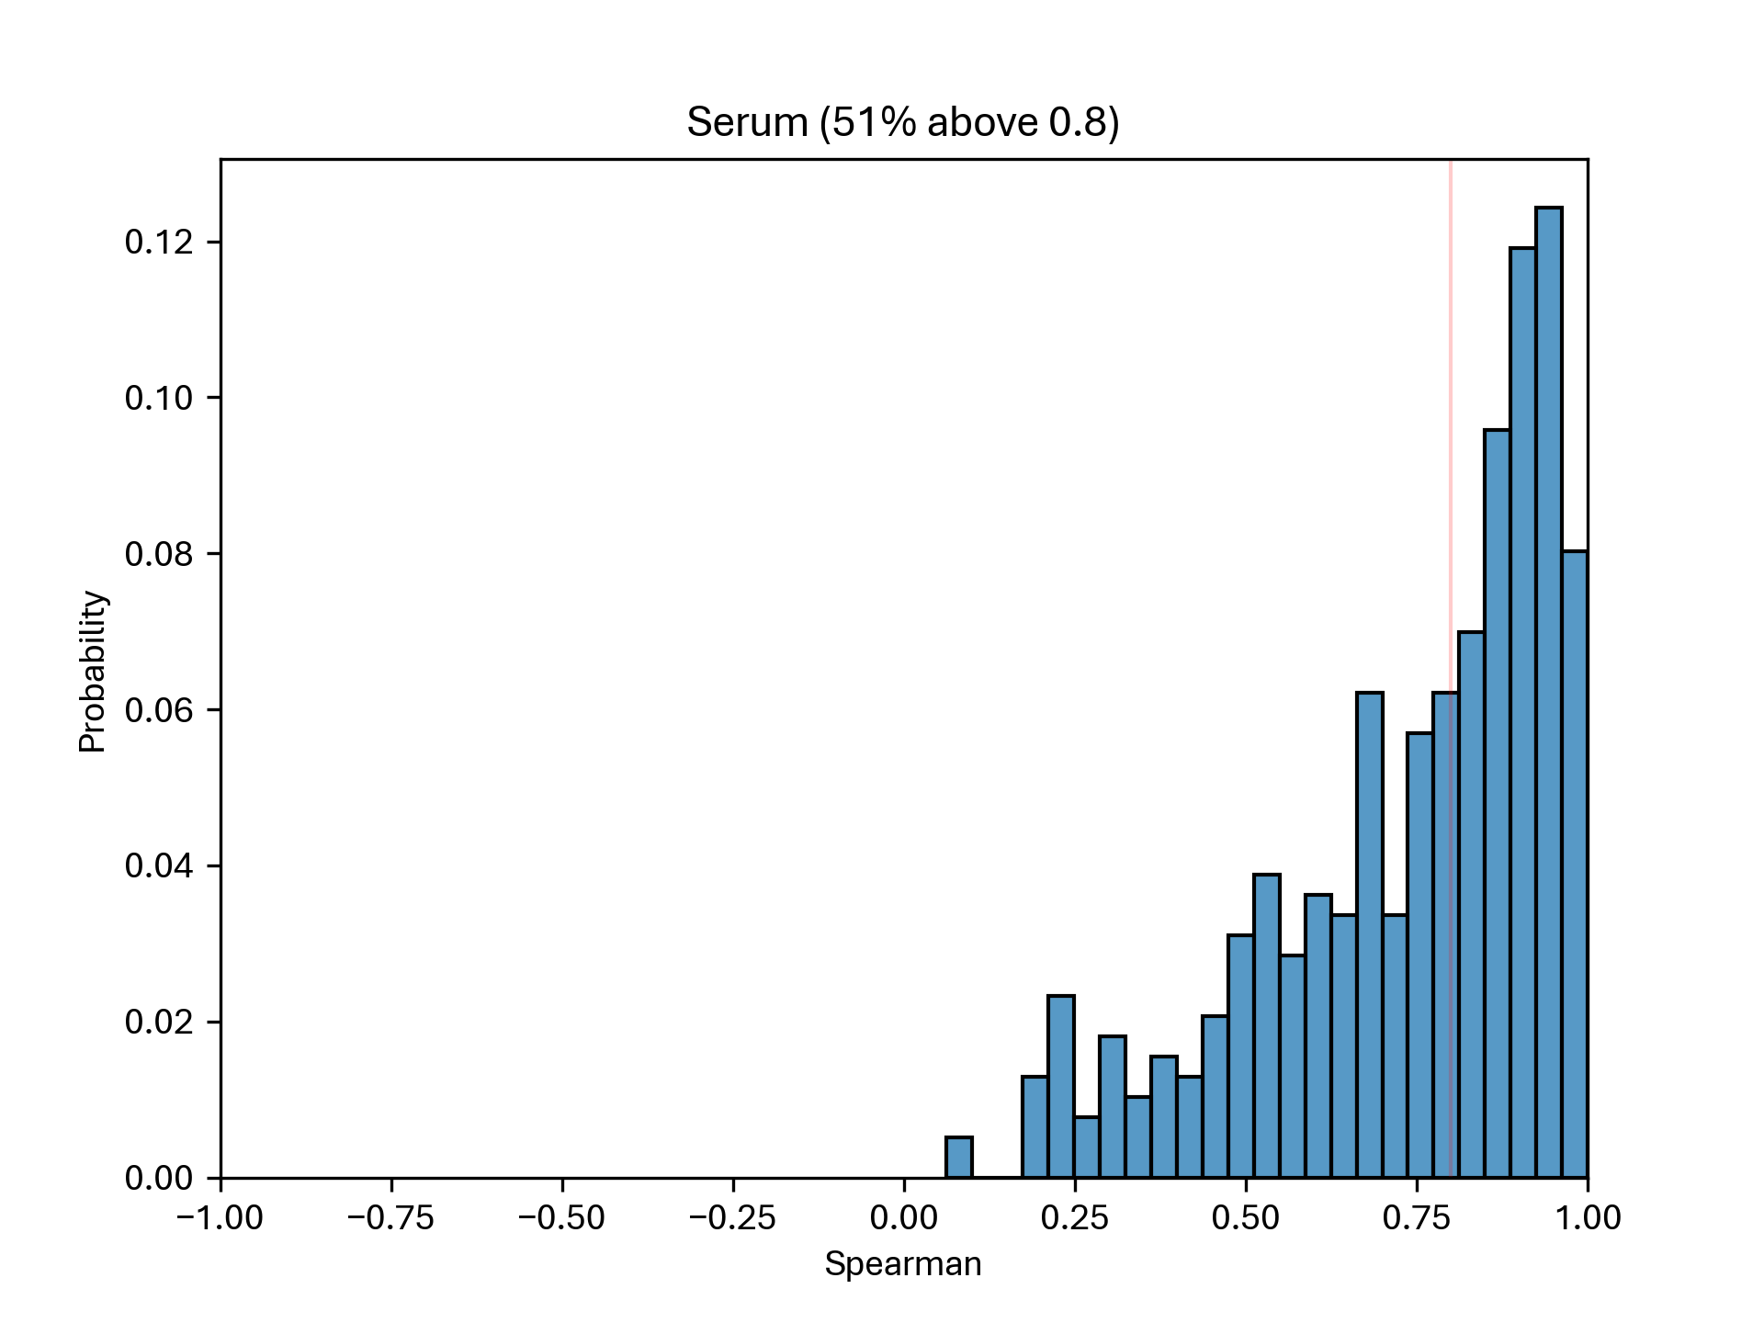
Spearman correlation – RAPs

Slide 14
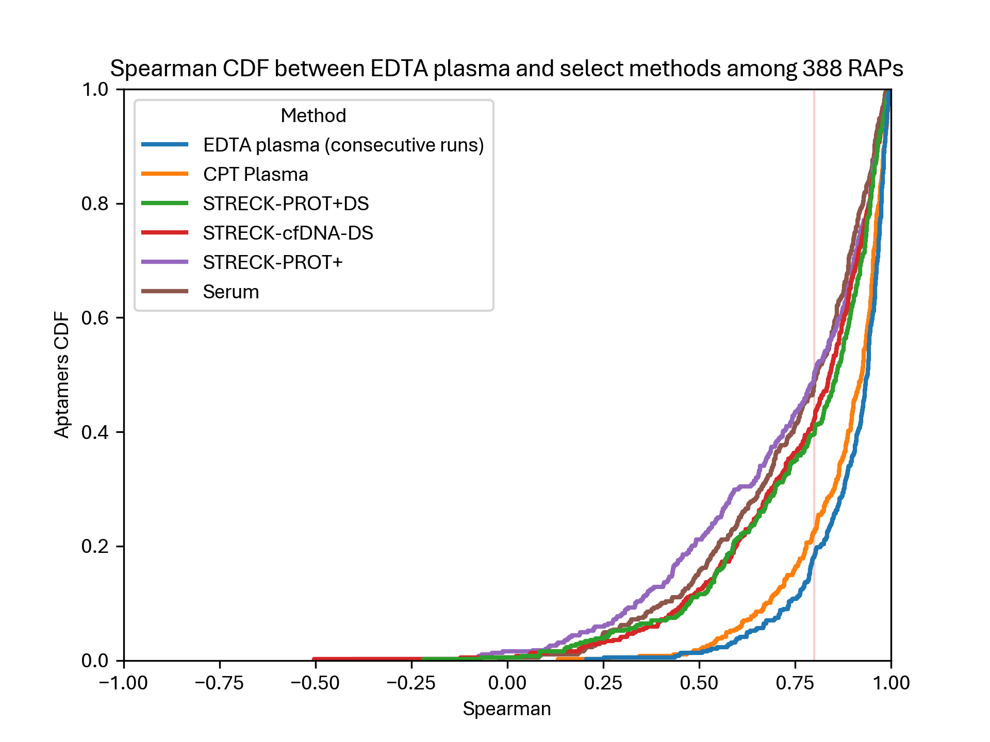
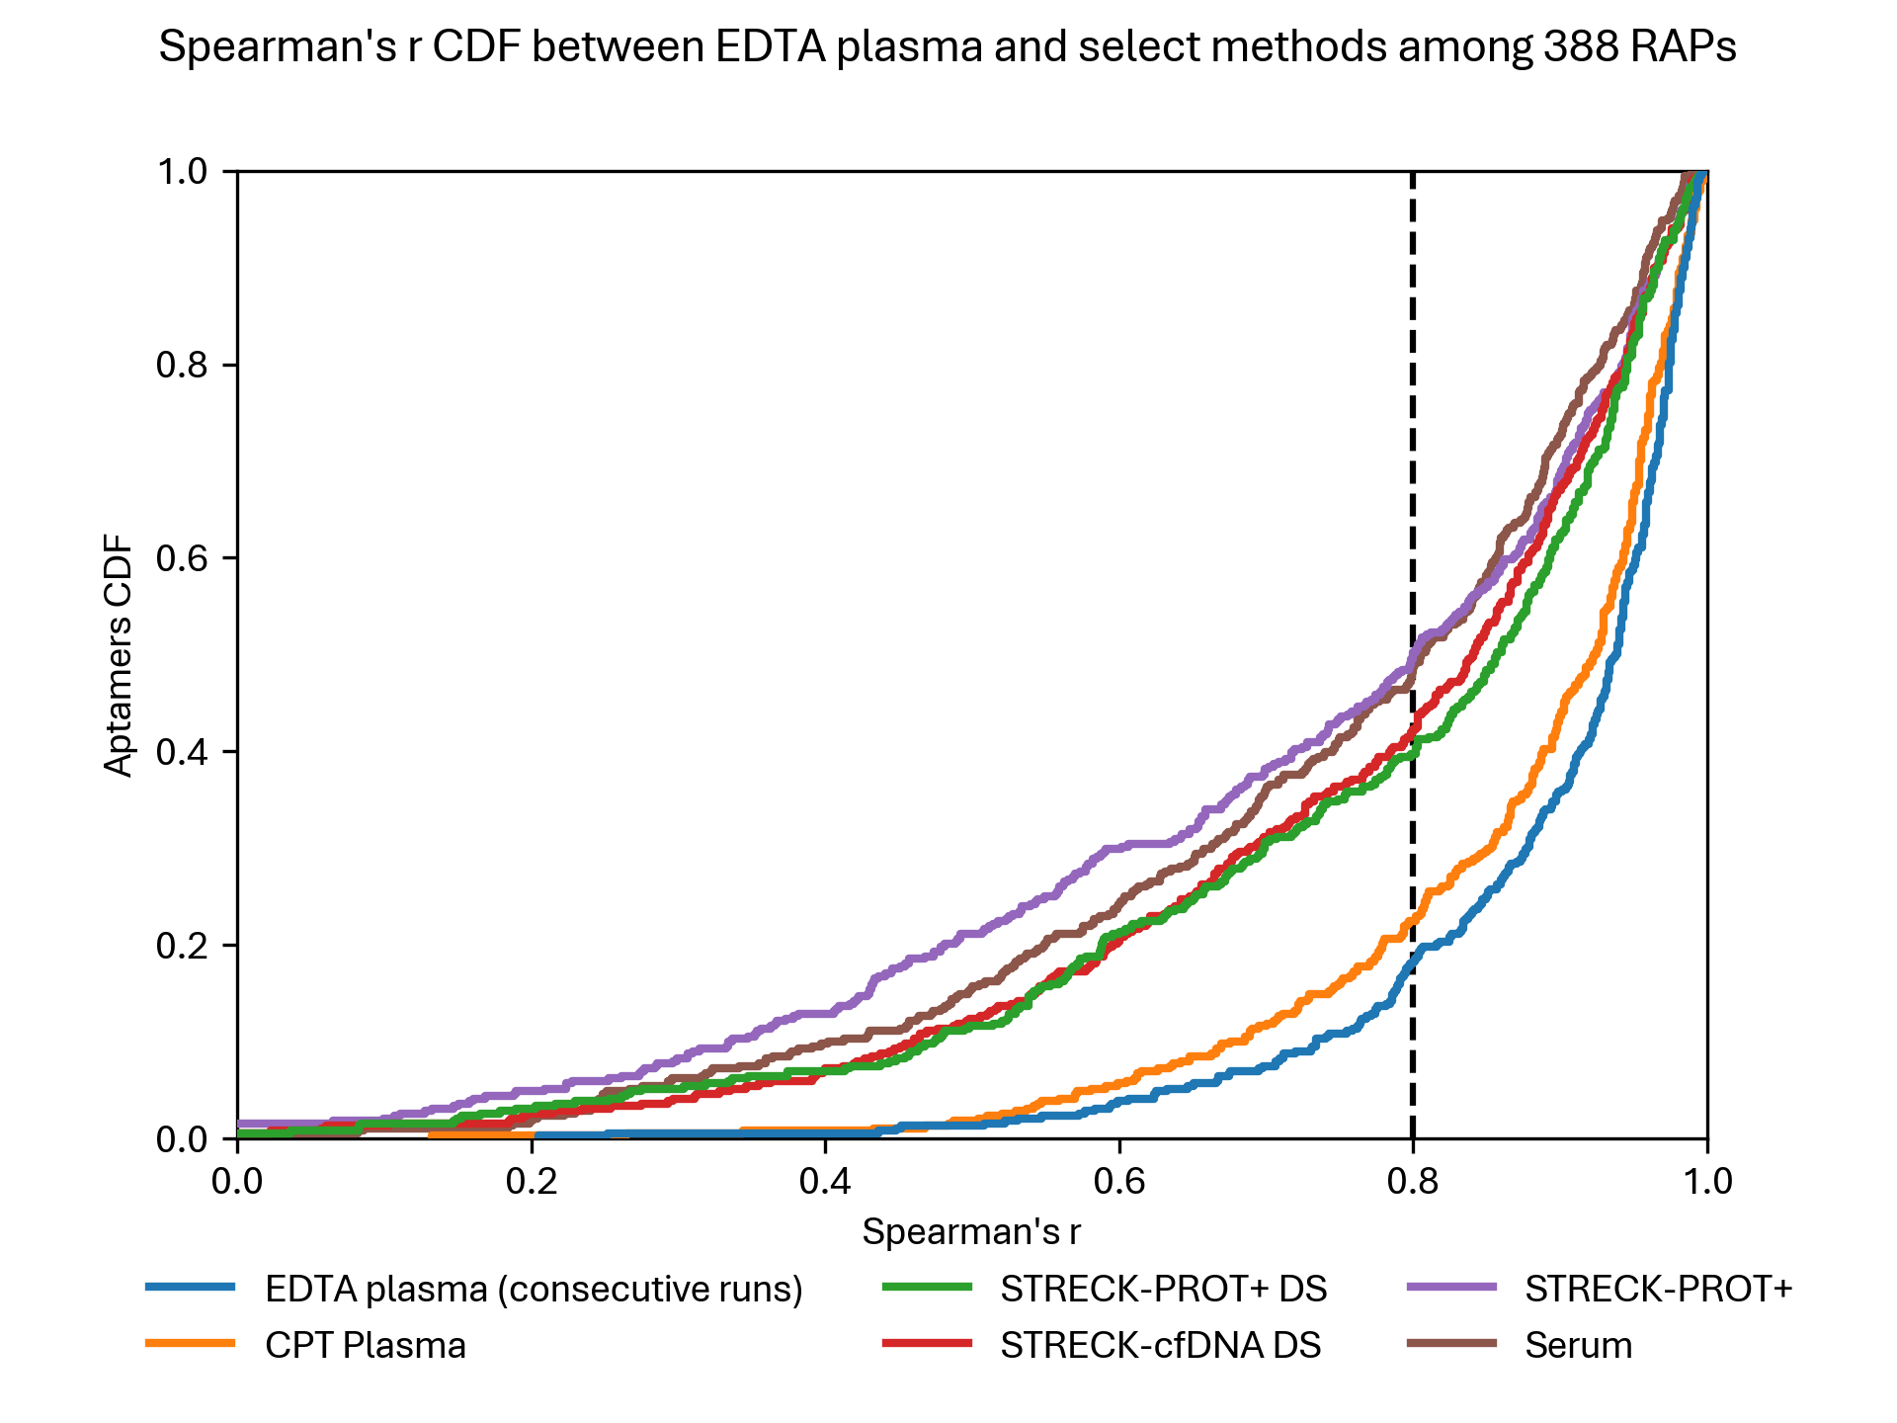
Spearman correlation – RAPs

Slide 15
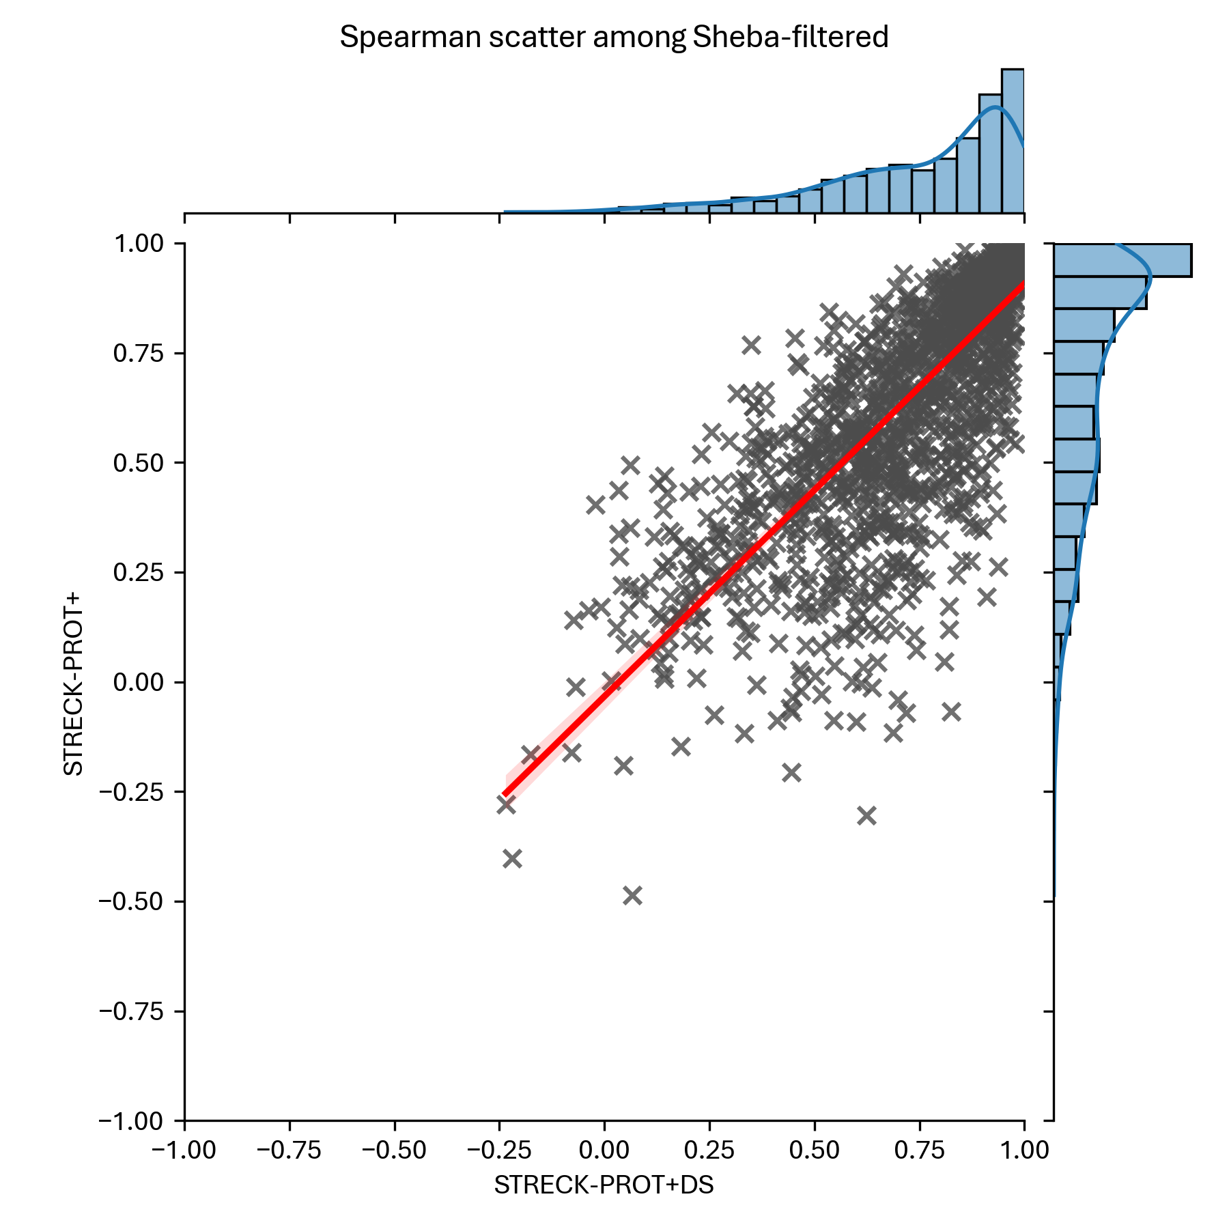
Spearman correlation – With/Without DS

Slide 16
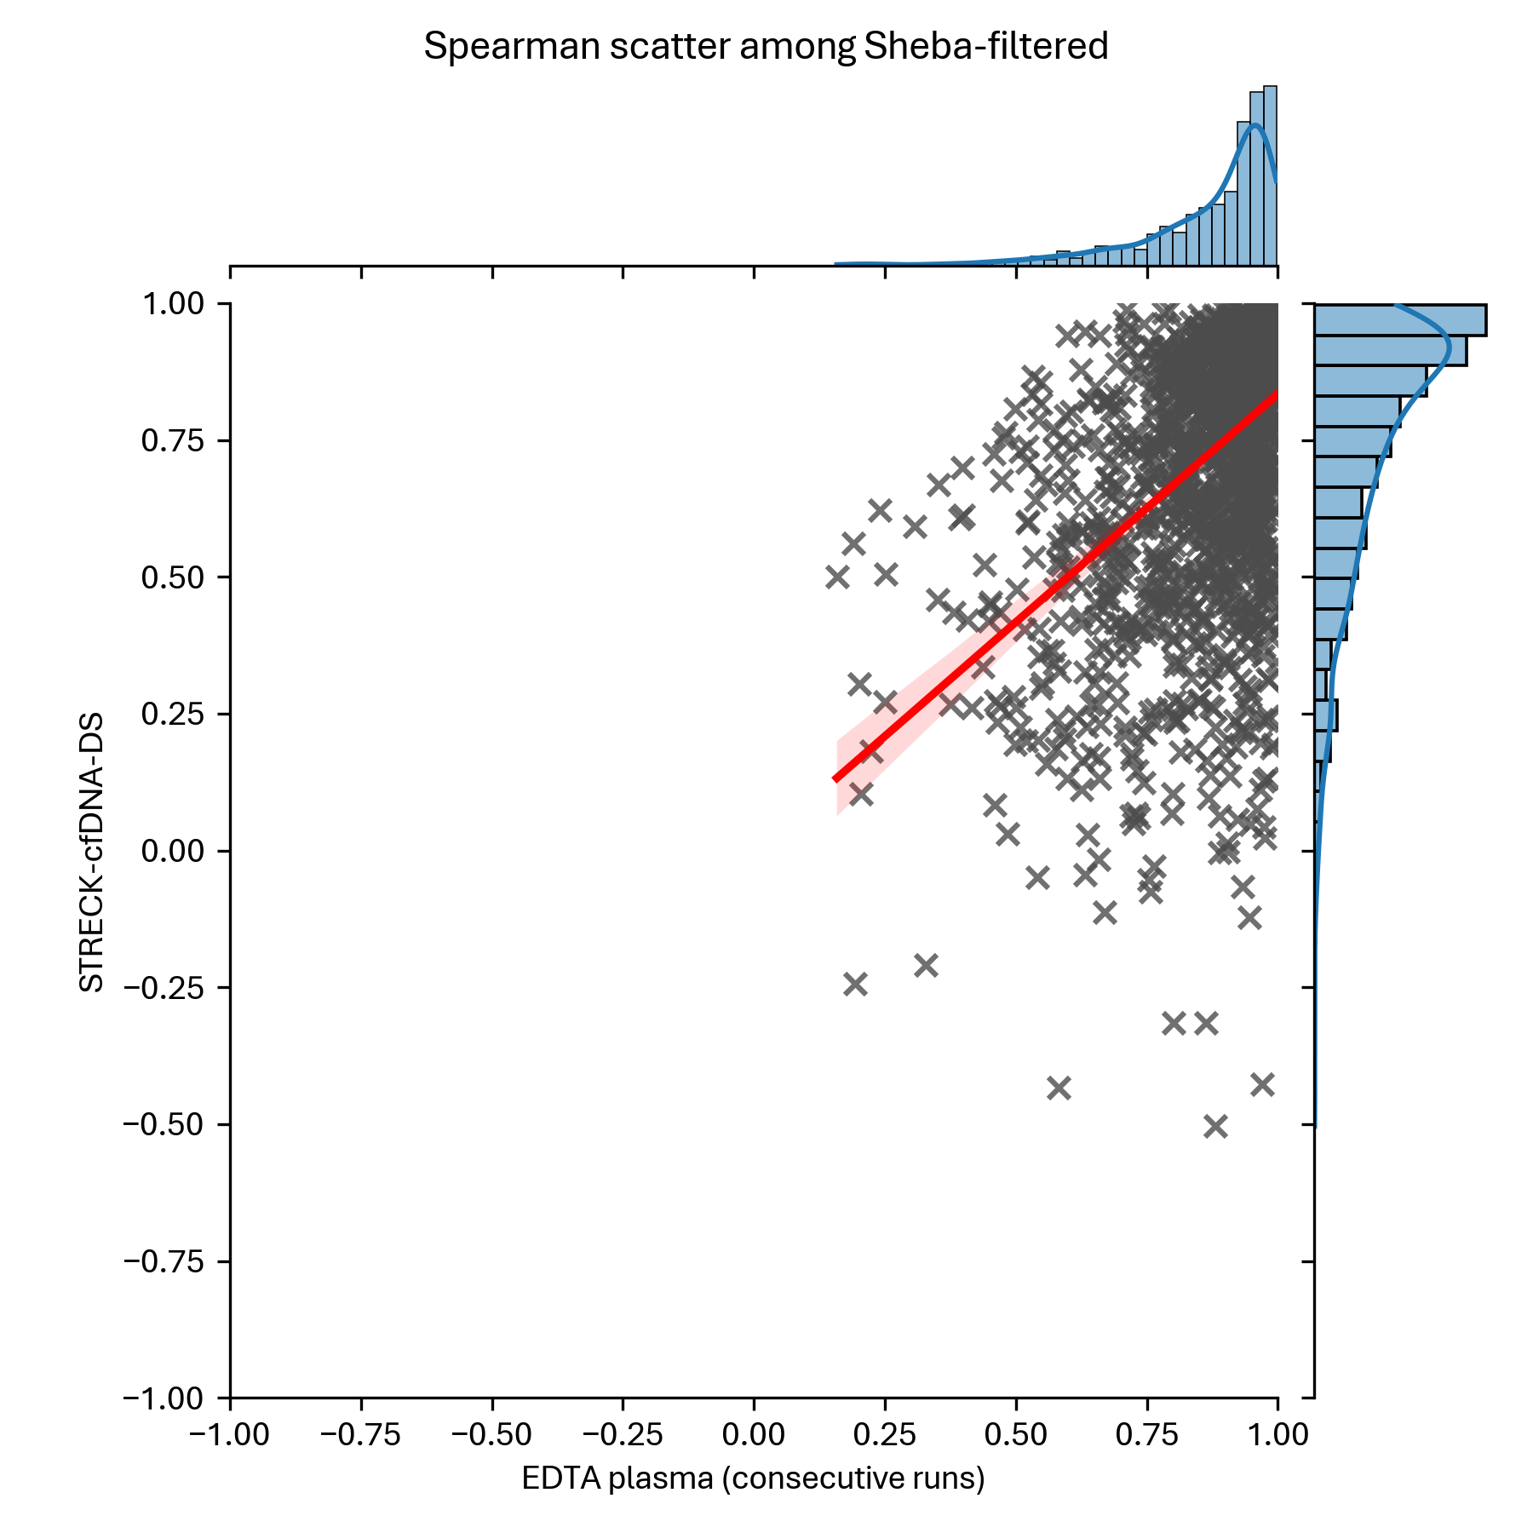
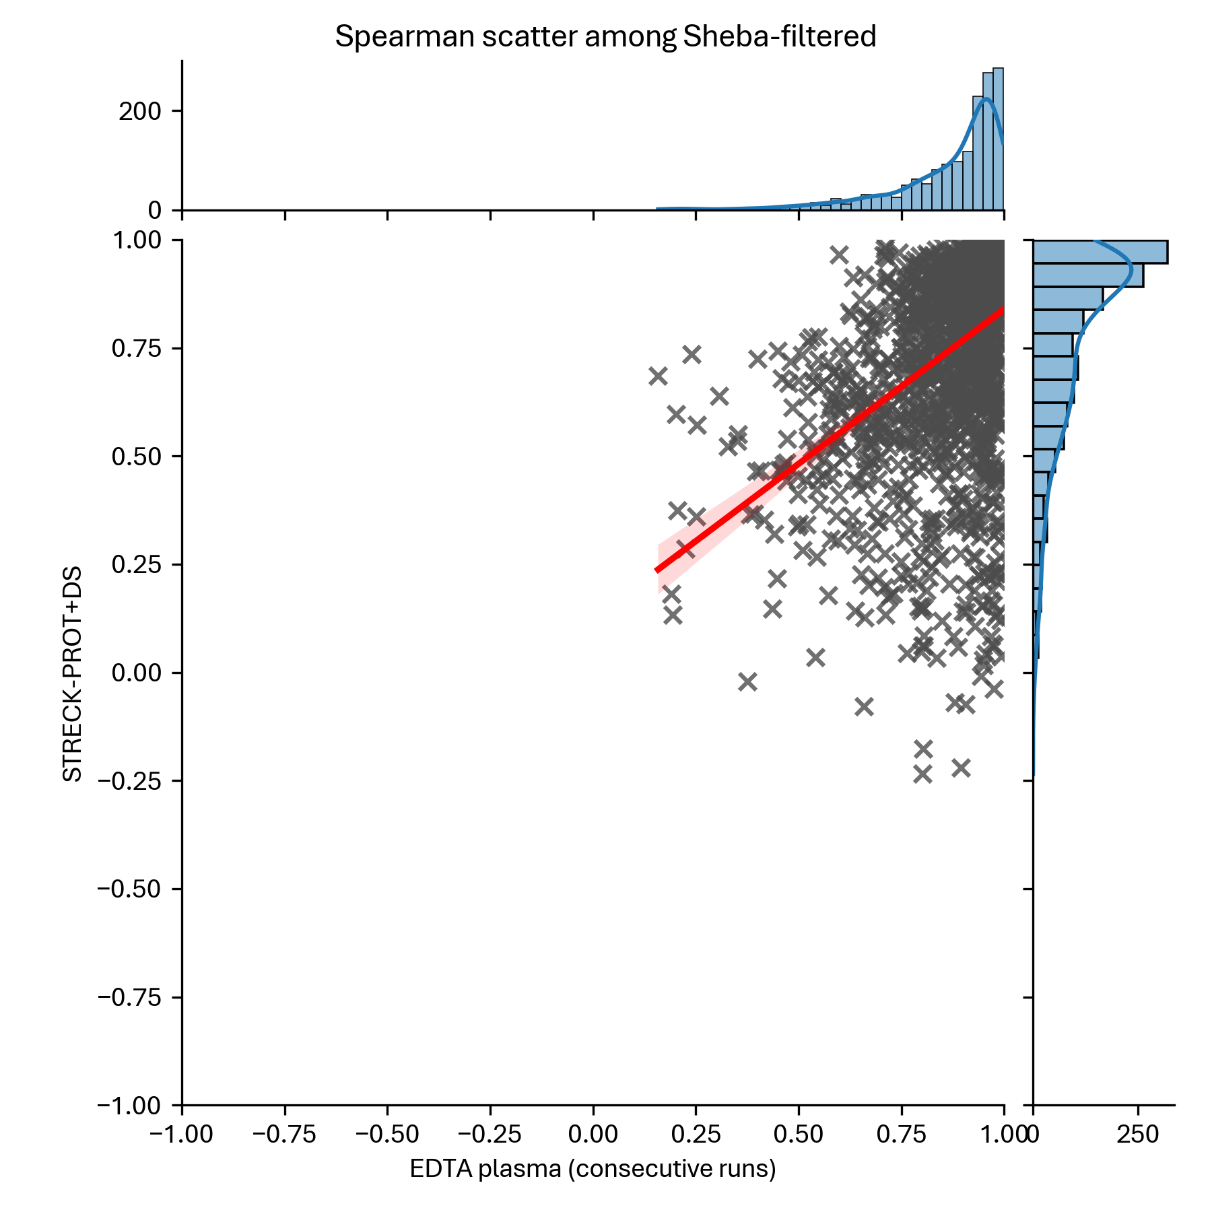
Spearman correlation – Streck Prot+ or cfDNA

Slide 17
Normalization

Slide 18
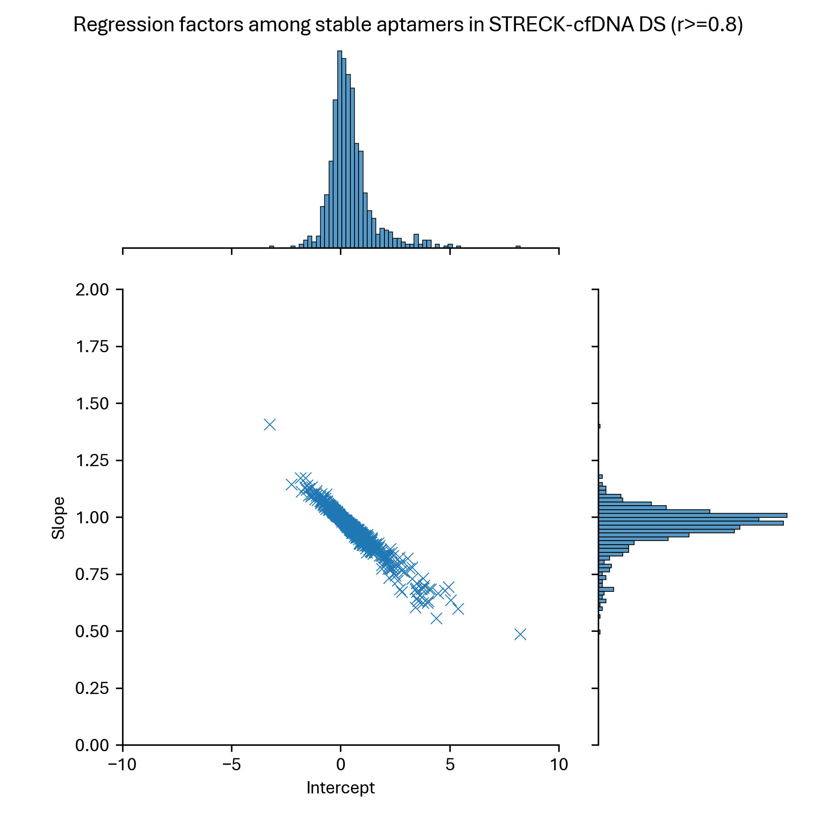
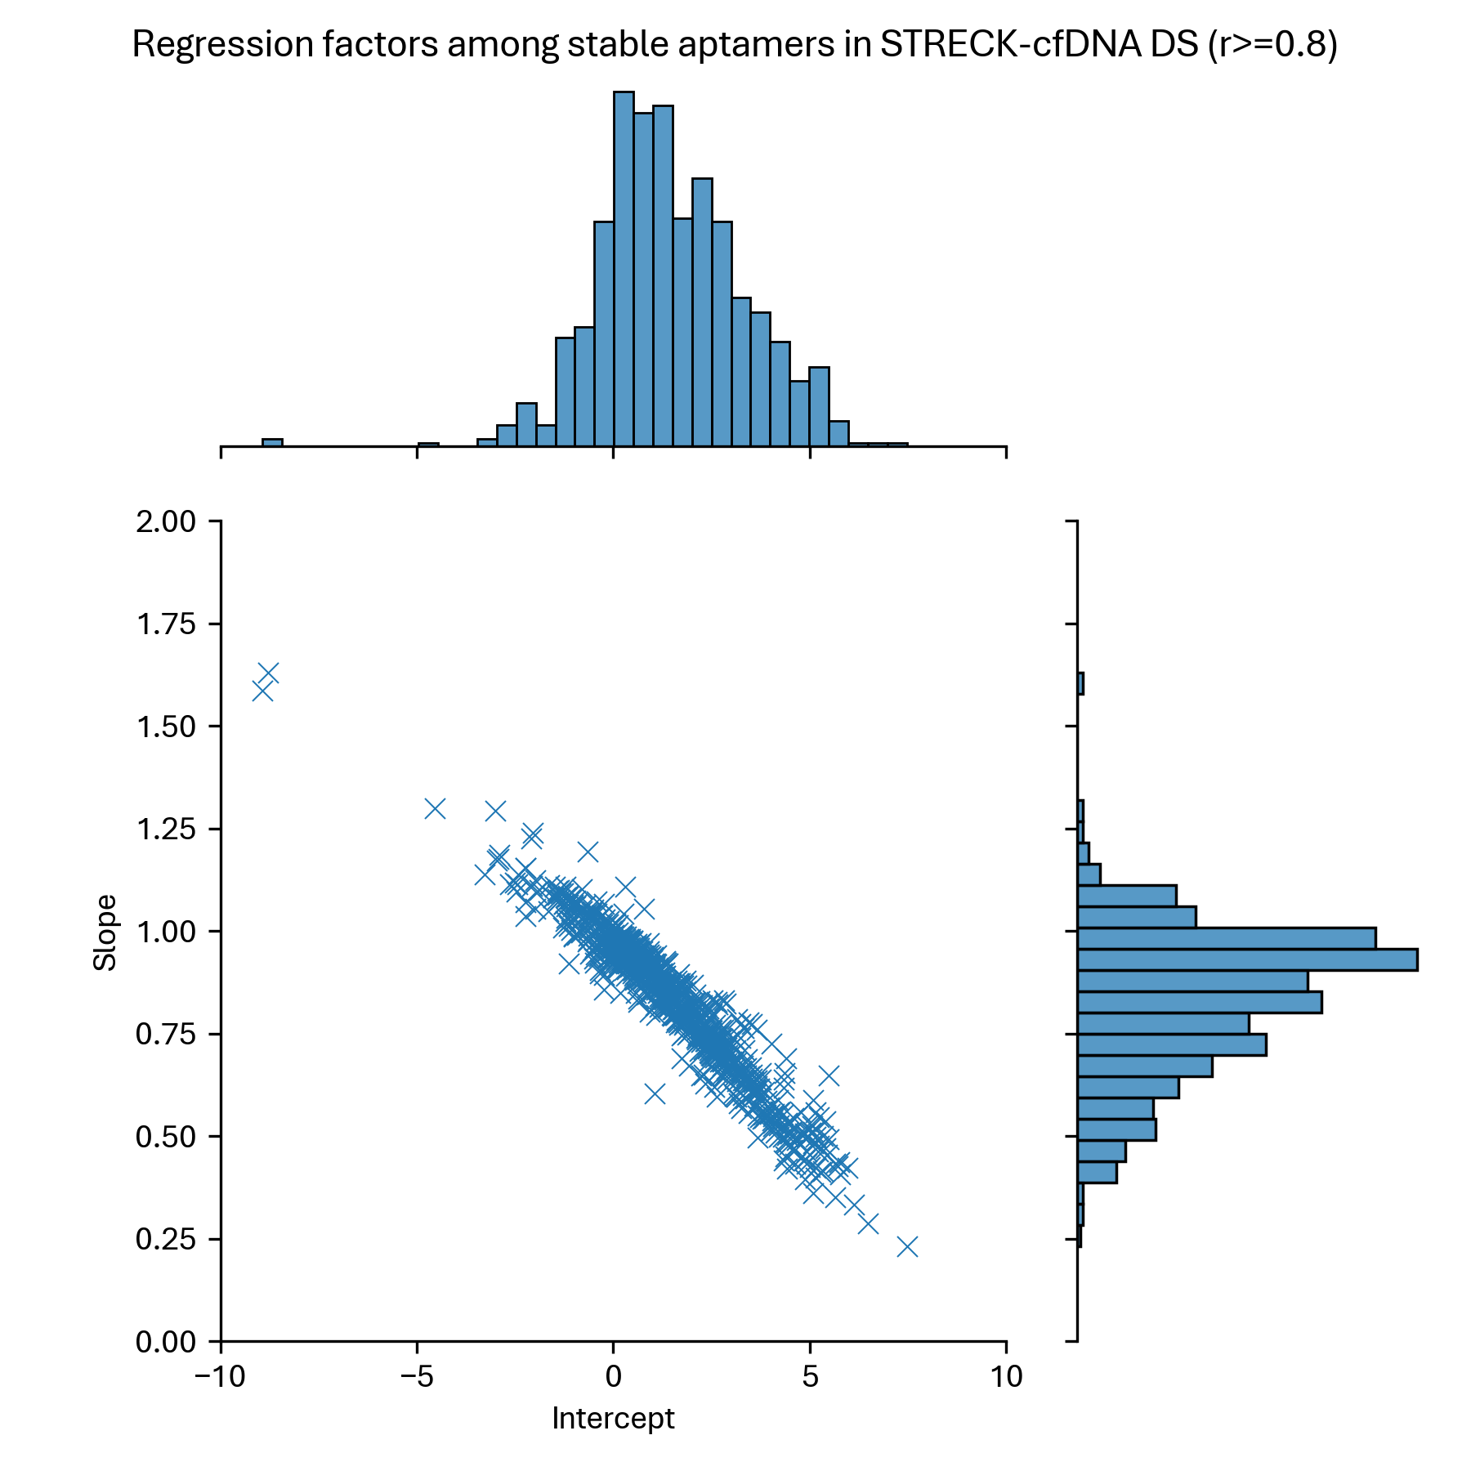
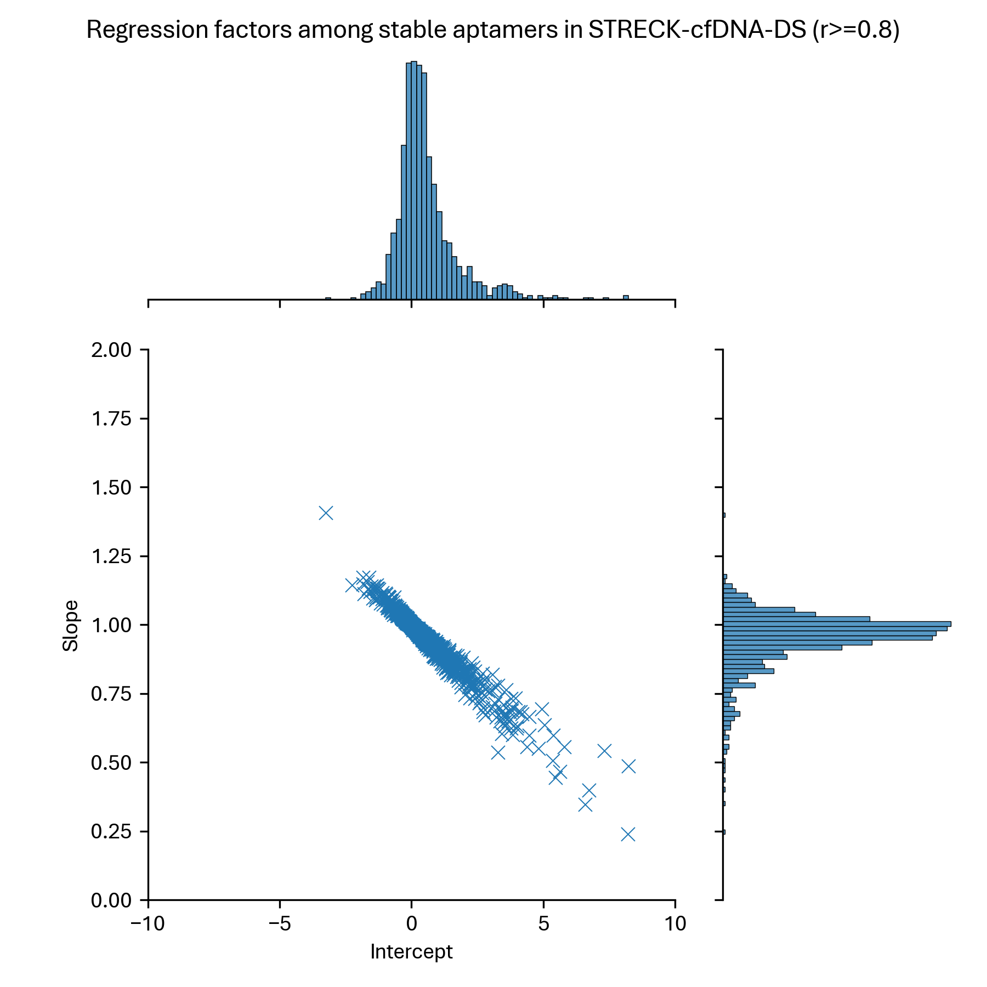
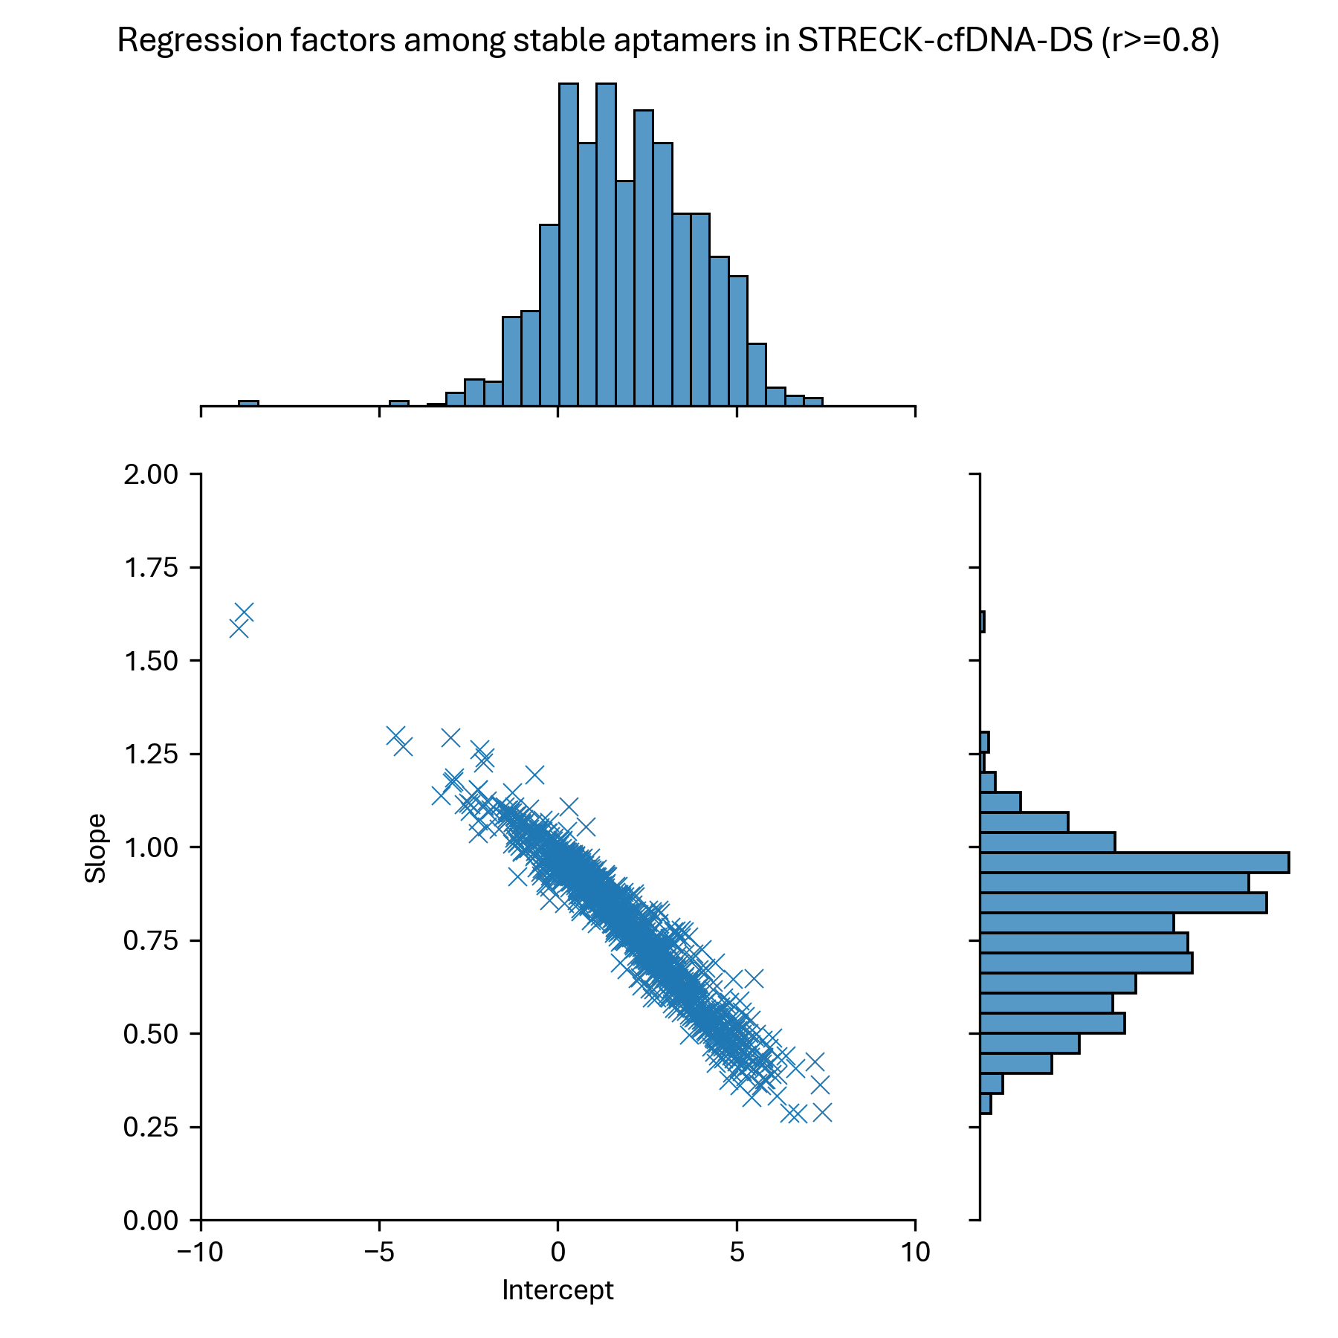
Consecutive EDTA vs Streck cfDNA
794 aptamers from Sheba filter, with Spearman’s r ≥ 0.8

Slide 19
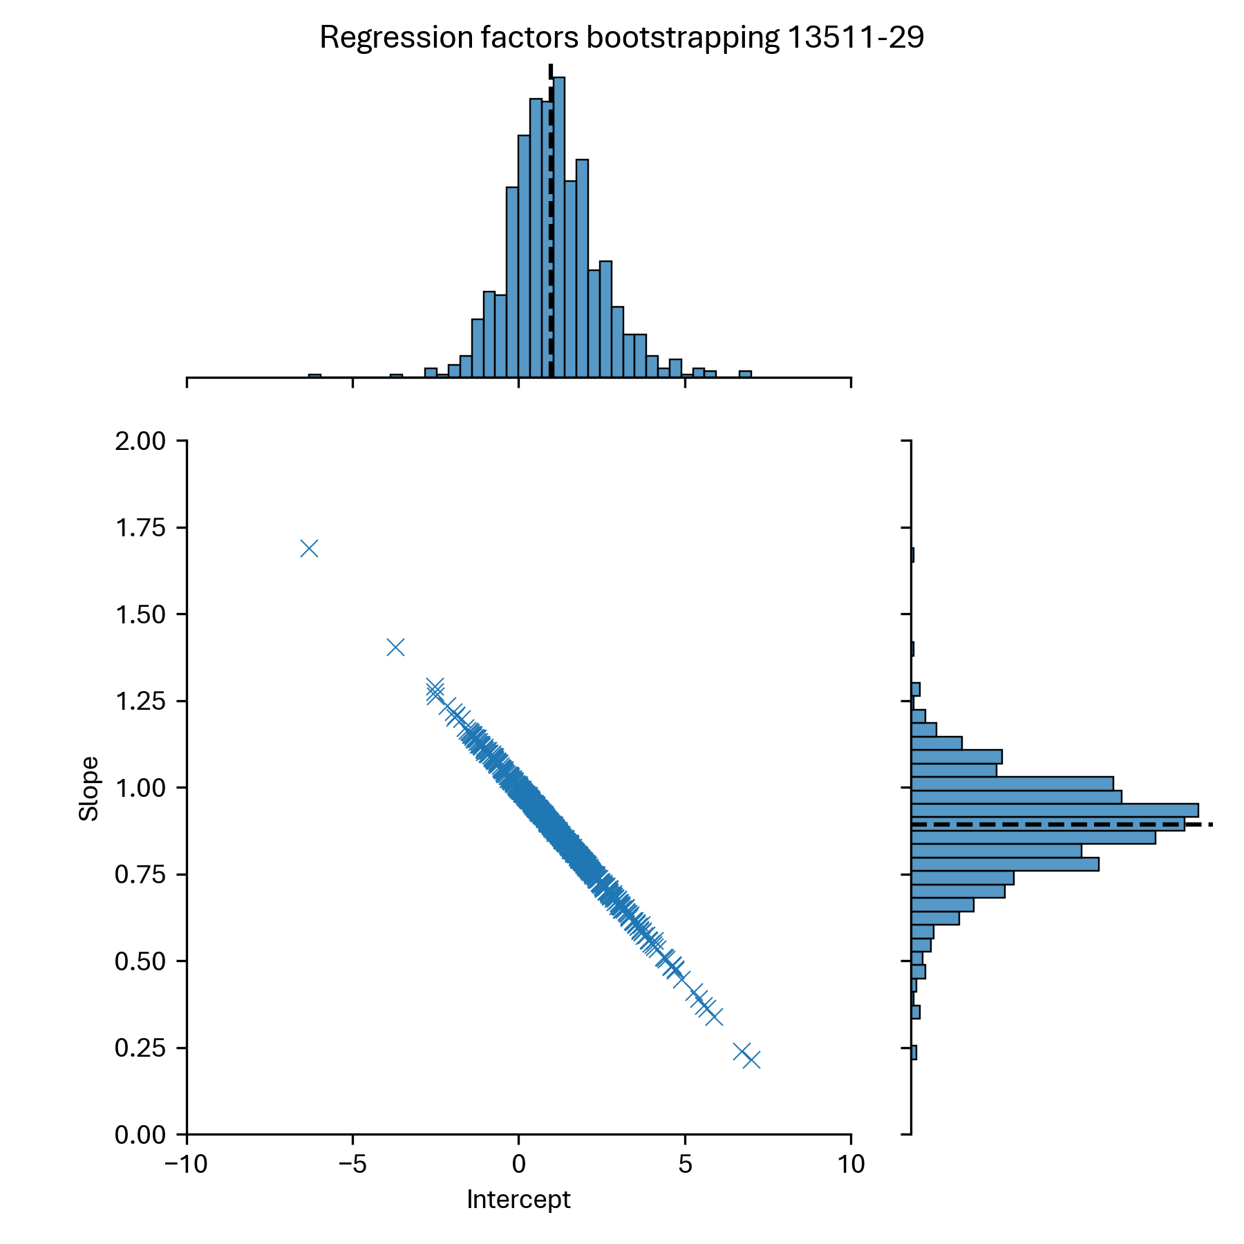
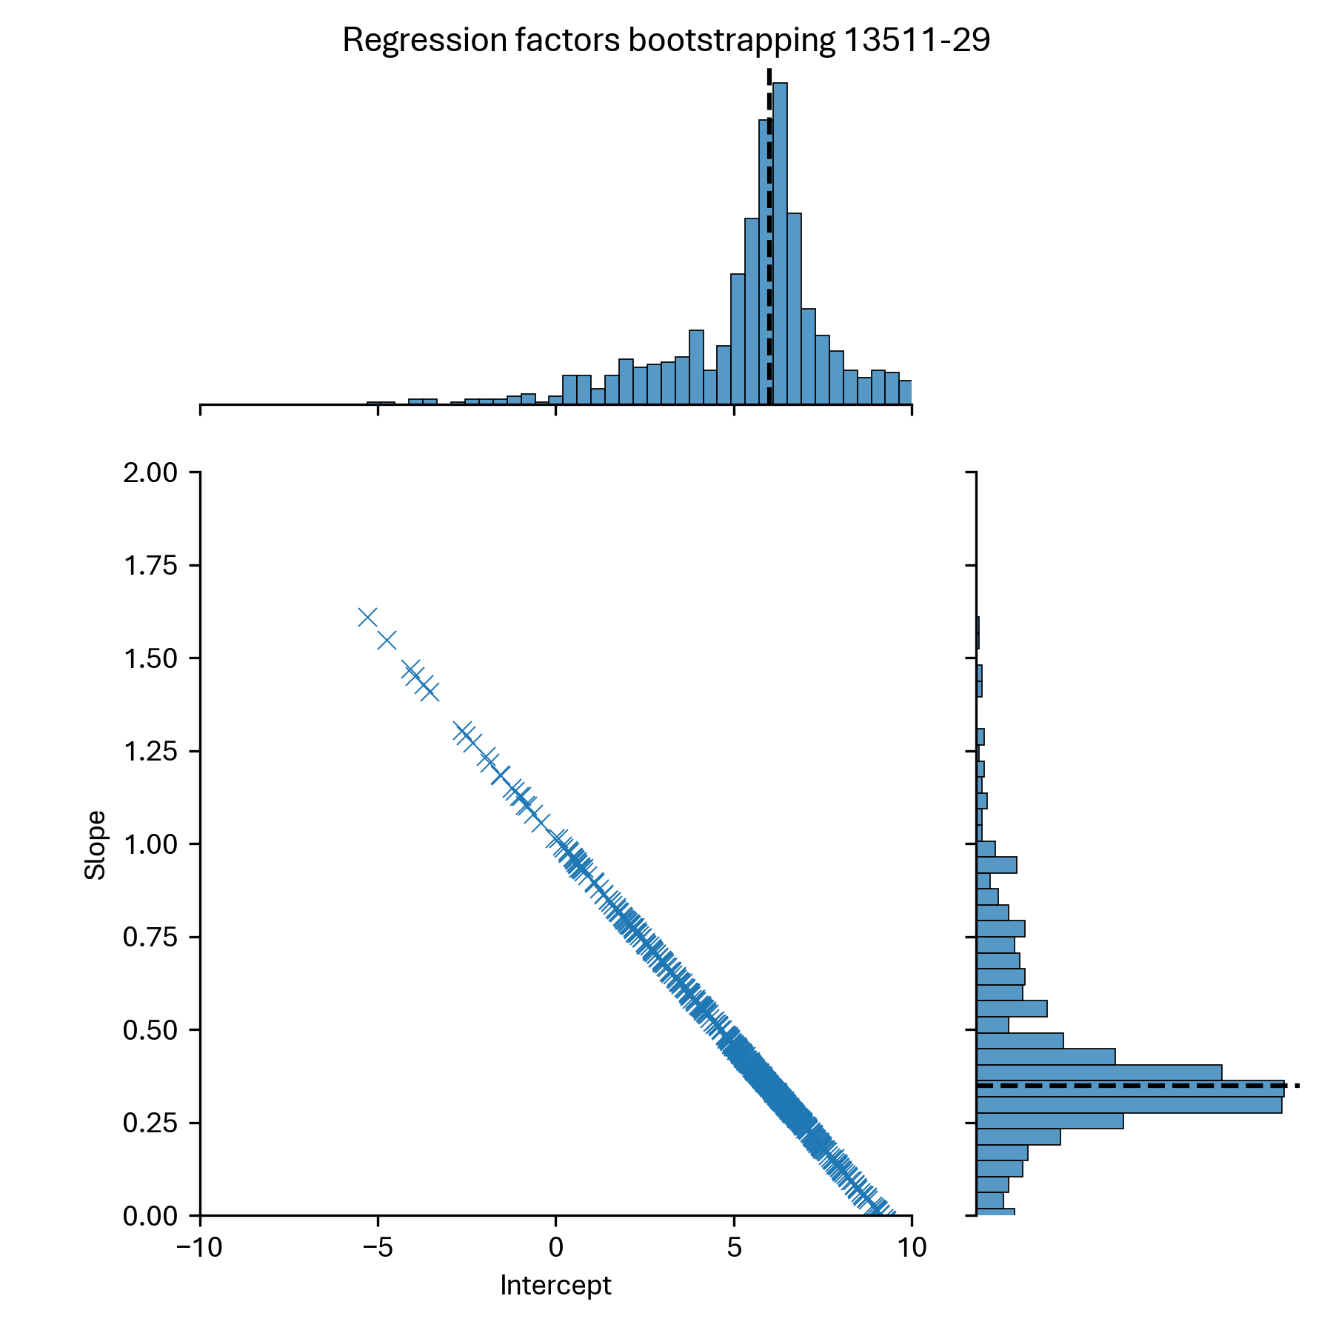
Bootstrap 1 aptamer (794 reps) Consecutive EDTA vs Streck cfDNA
Baseline values
(without bootstrapping)

Slide 20
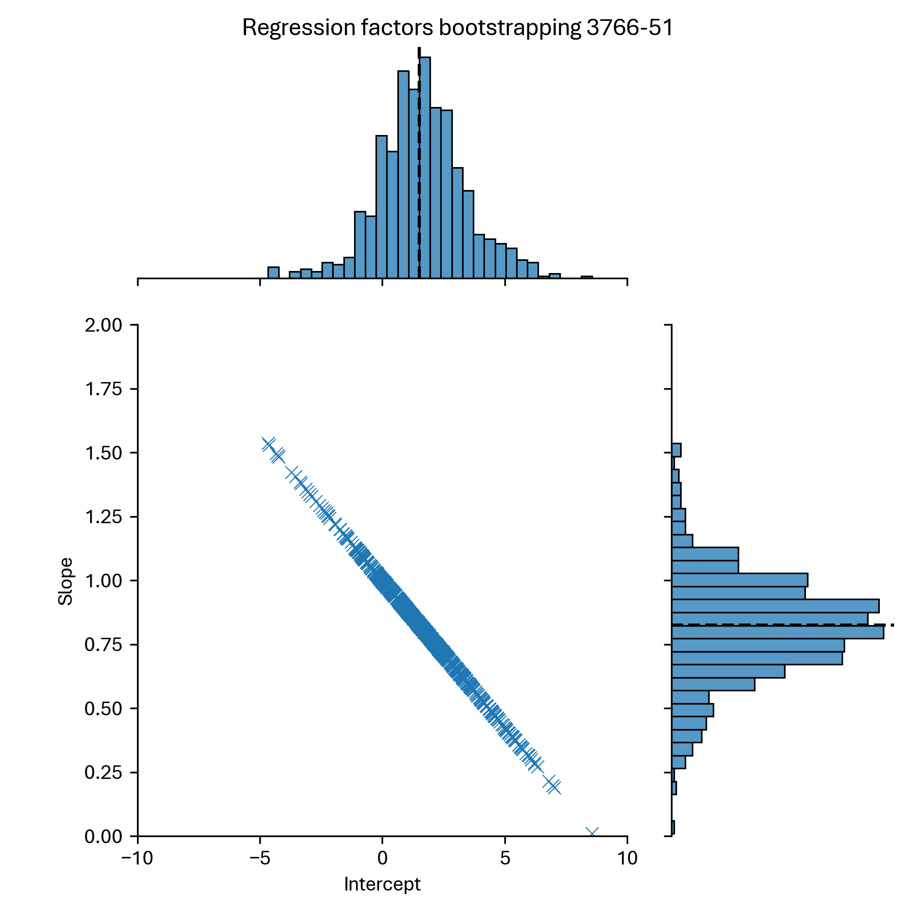
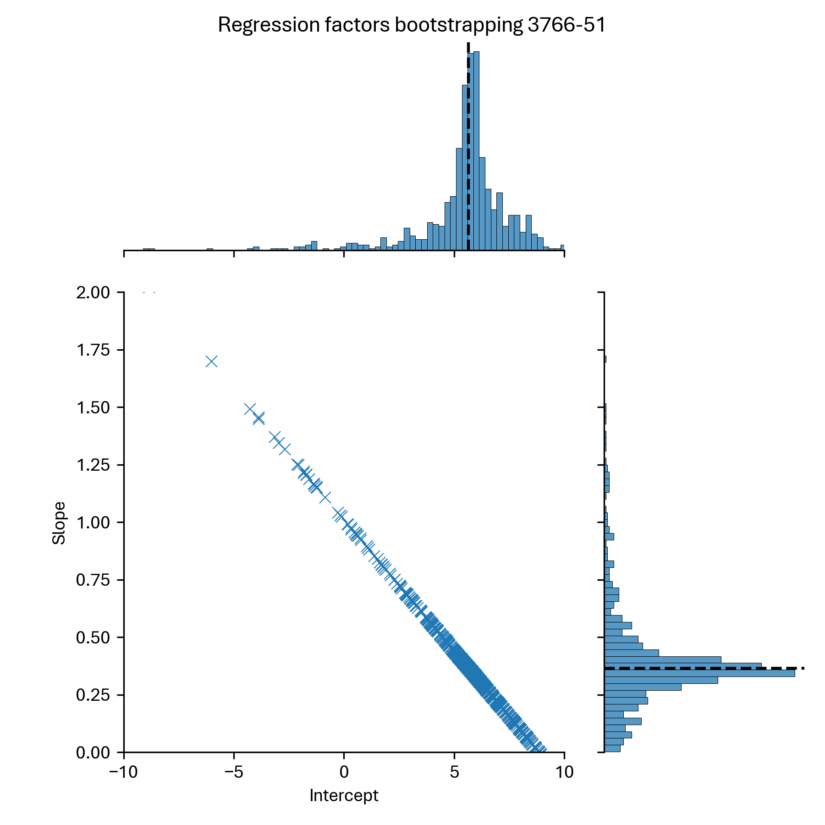
Bootstrap 1 aptamer (794 reps) Consecutive EDTA vs Streck cfDNA
Baseline values
(without bootstrapping)

Slide 21

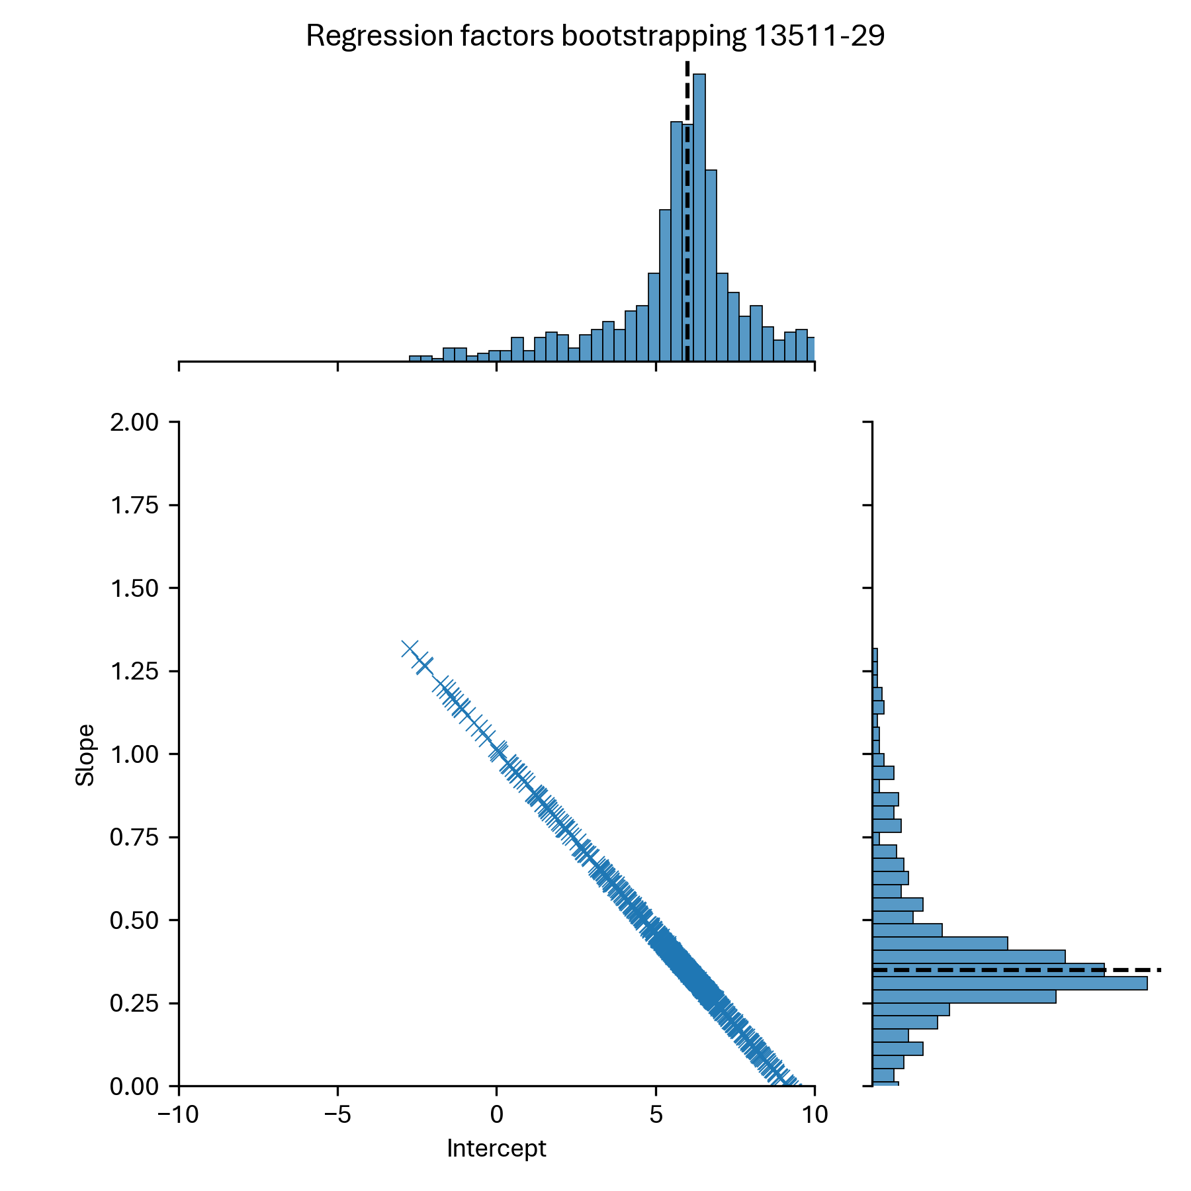
Bootstrap 1 aptamer (794 reps) Consecutive EDTA vs Streck cfDNA
Baseline values
(without bootstrapping)

Slide 22
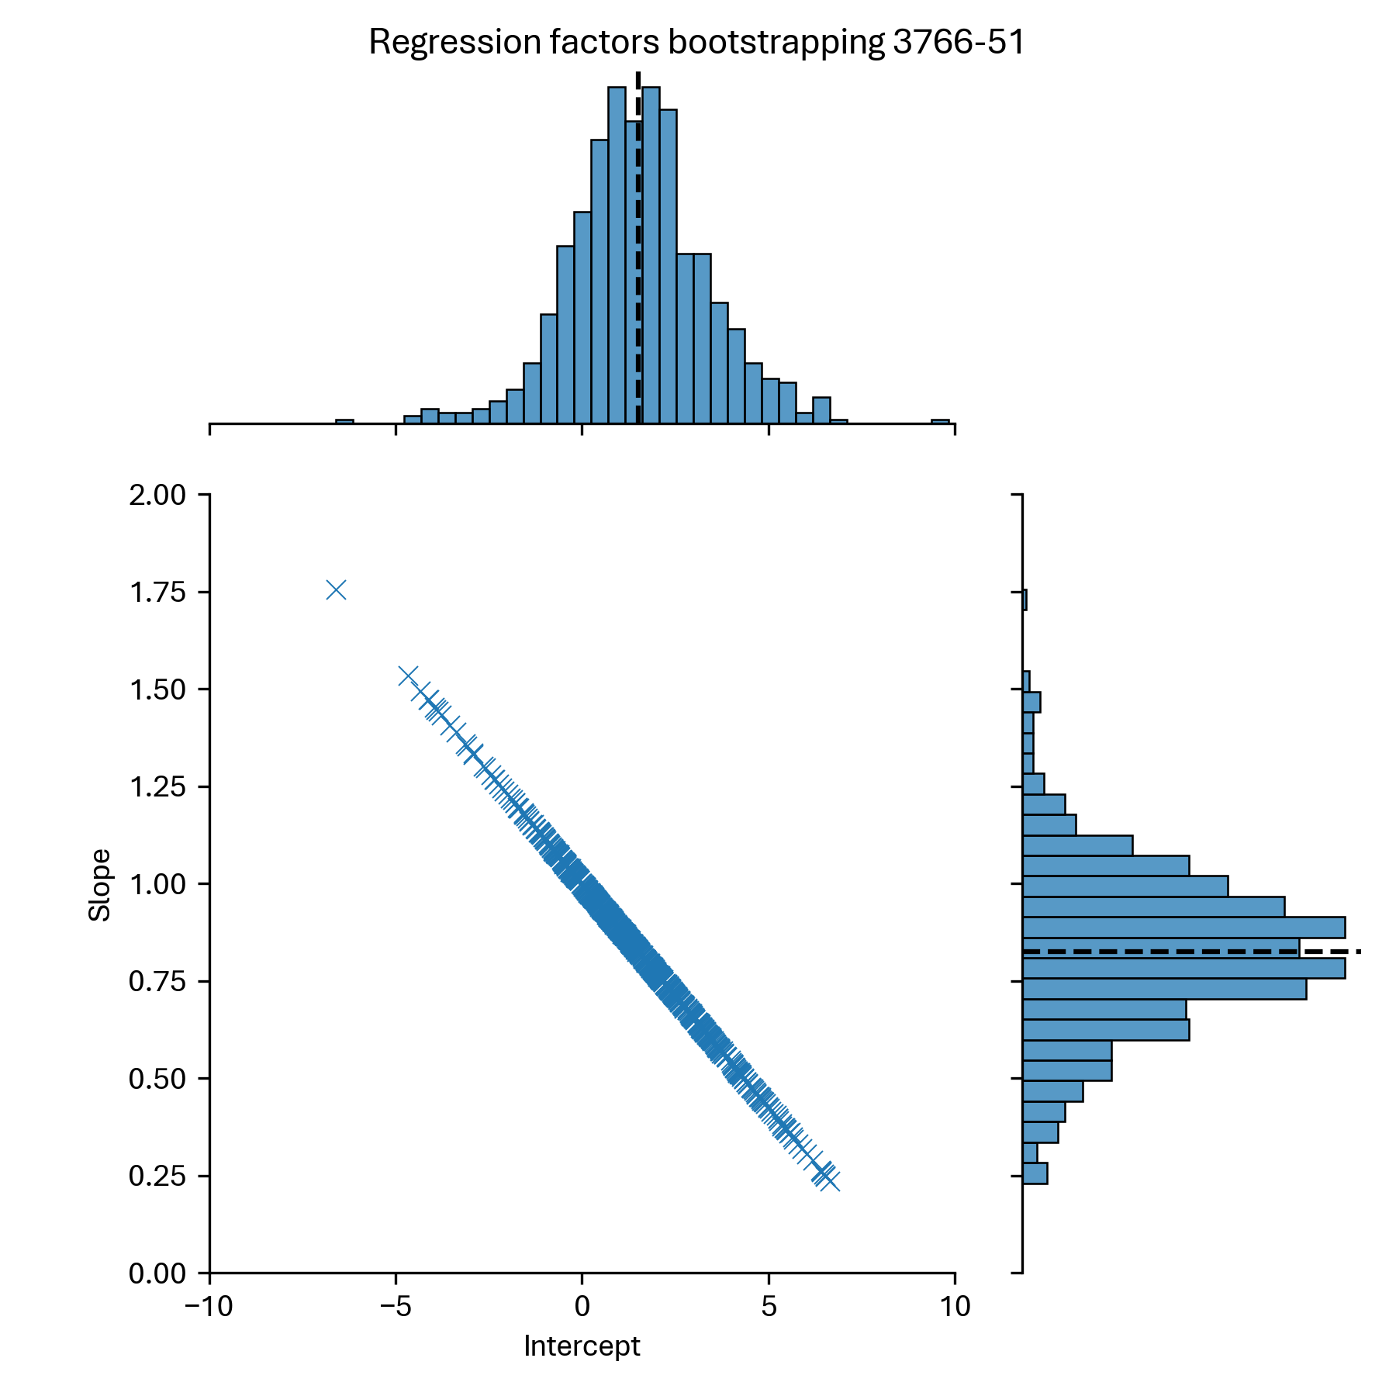
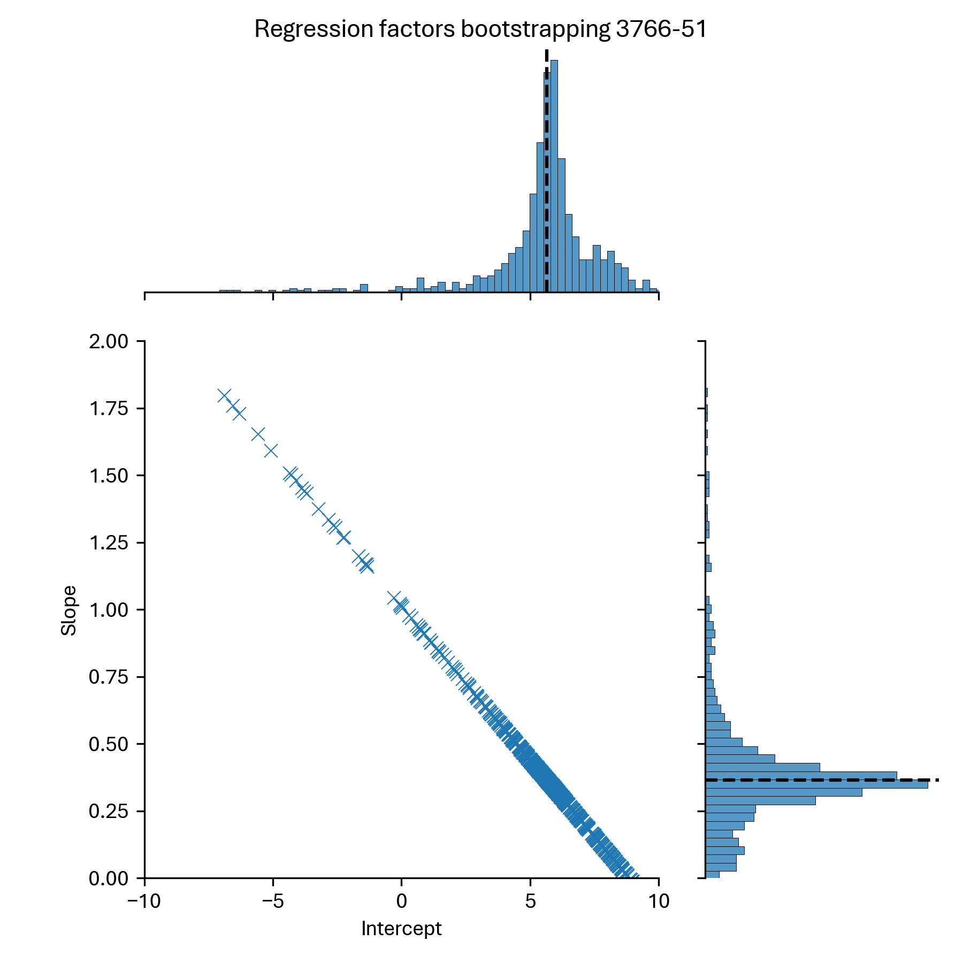
Bootstrap 1 aptamer (794 reps) Consecutive EDTA vs Streck cfDNA
Baseline values
(without bootstrapping)

Slide 23
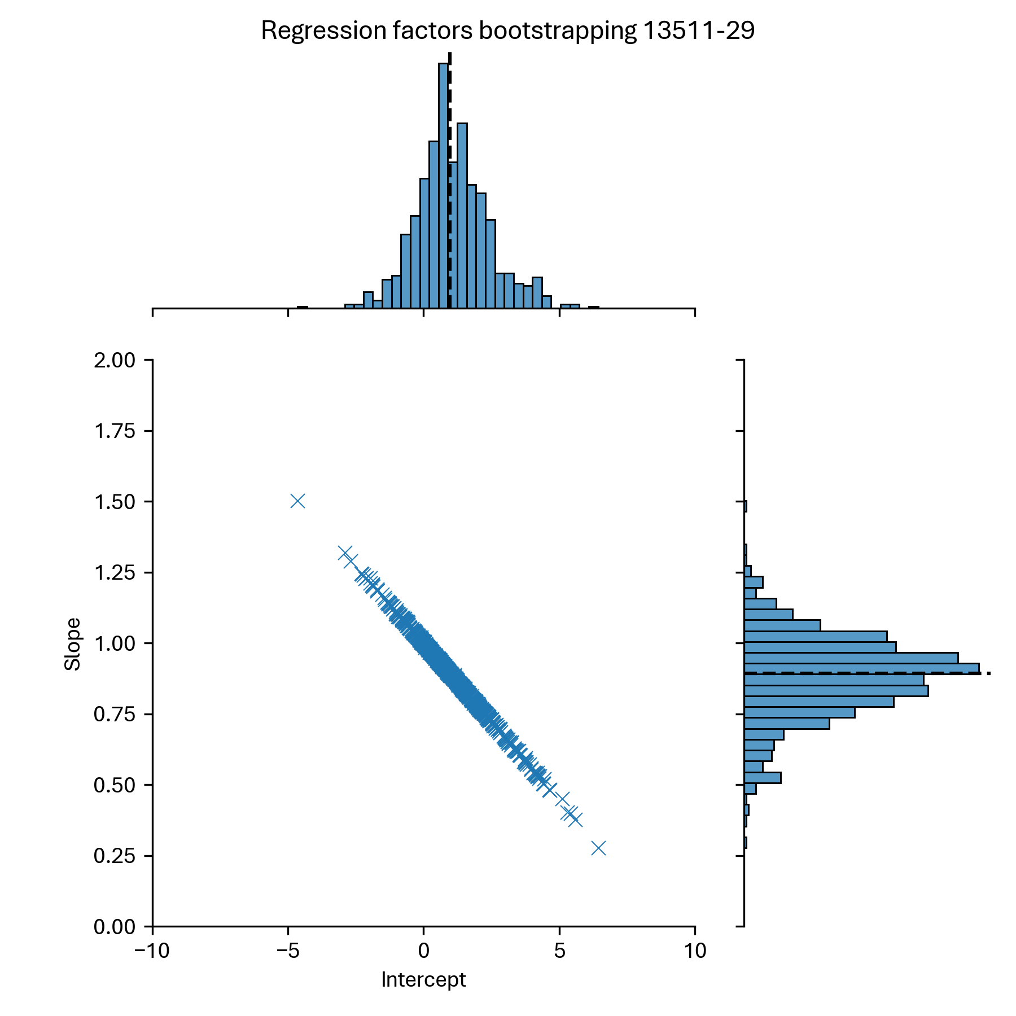
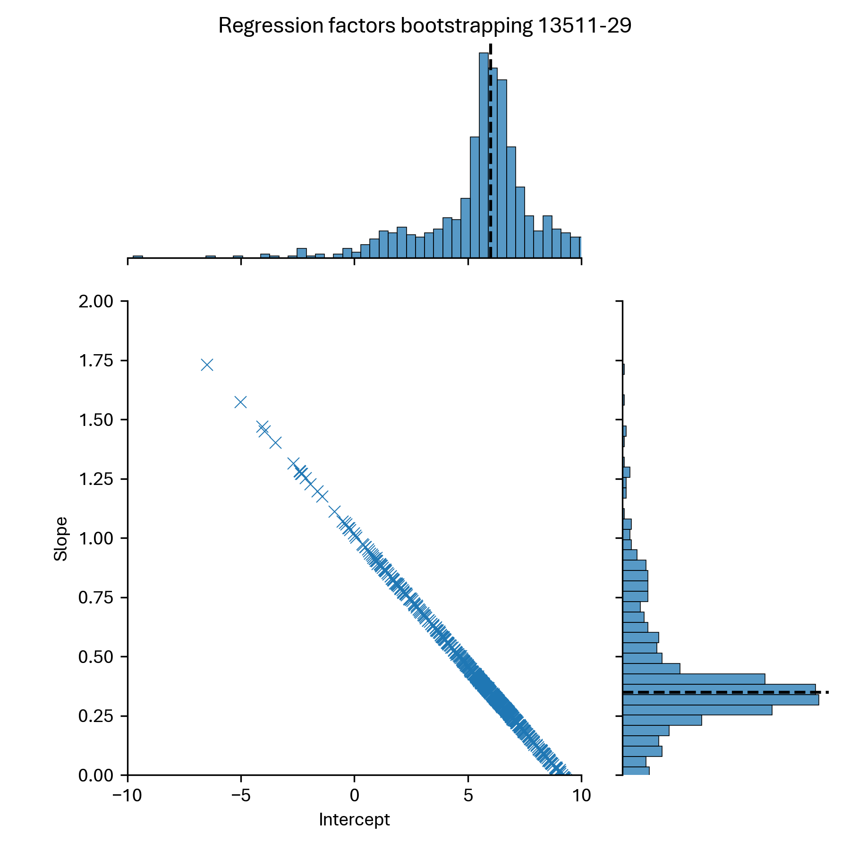
Bootstrap 1 aptamer (794 reps) Consecutive EDTA vs Streck cfDNA
Baseline values
(without bootstrapping)

Slide 24
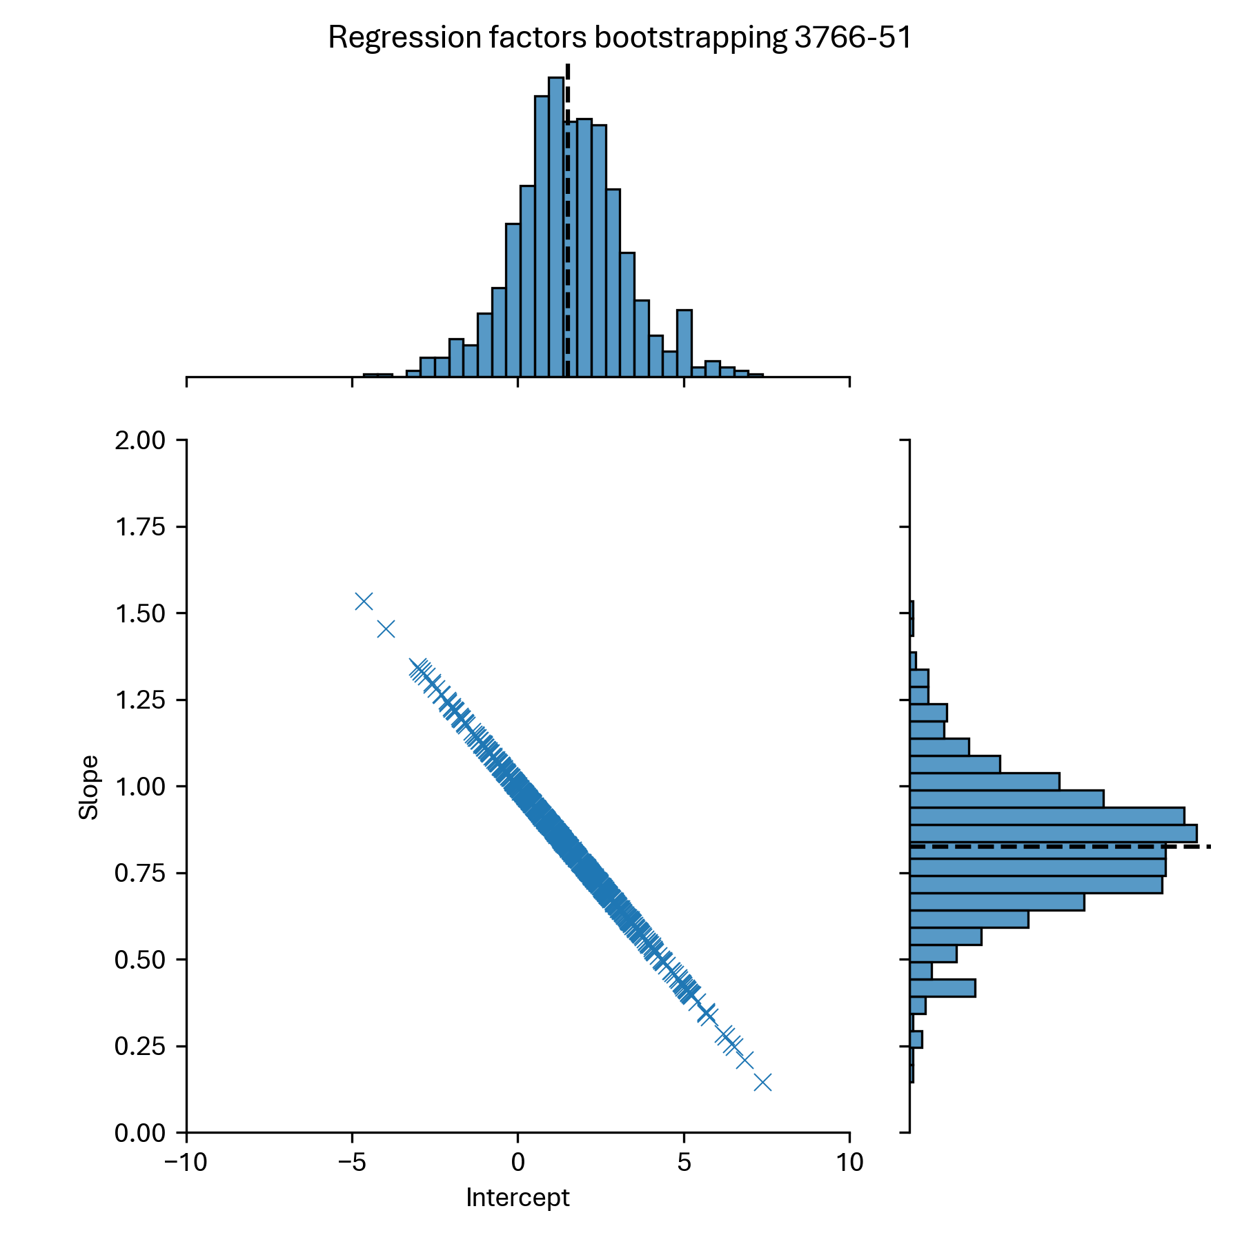
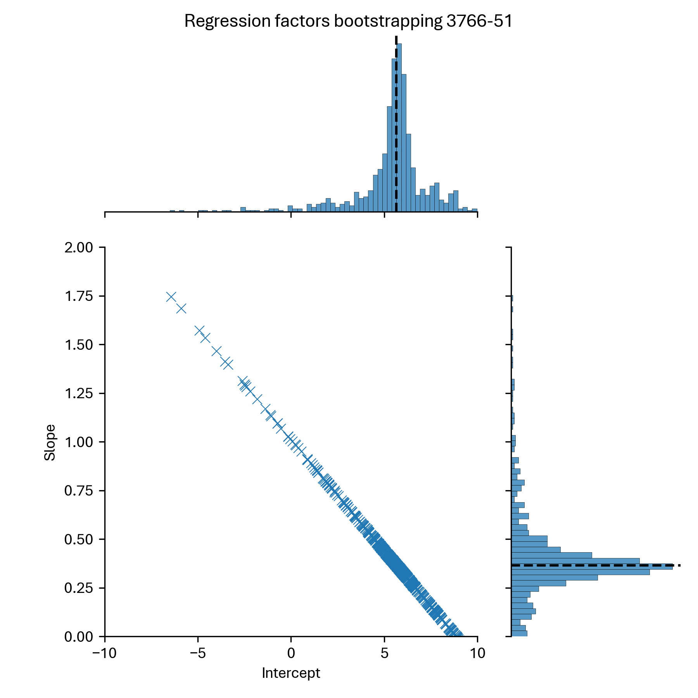
Bootstrap 1 aptamer (794 reps) Consecutive EDTA vs Streck cfDNA
Baseline values
(without bootstrapping)

Slide 25
RAPs

Slide 26
Spearman correlation – RAPs

Slide 27
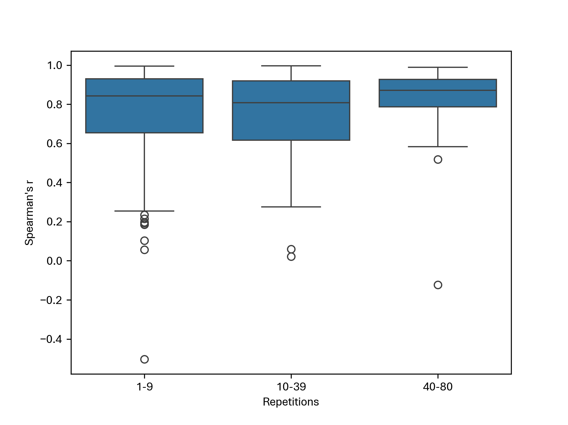
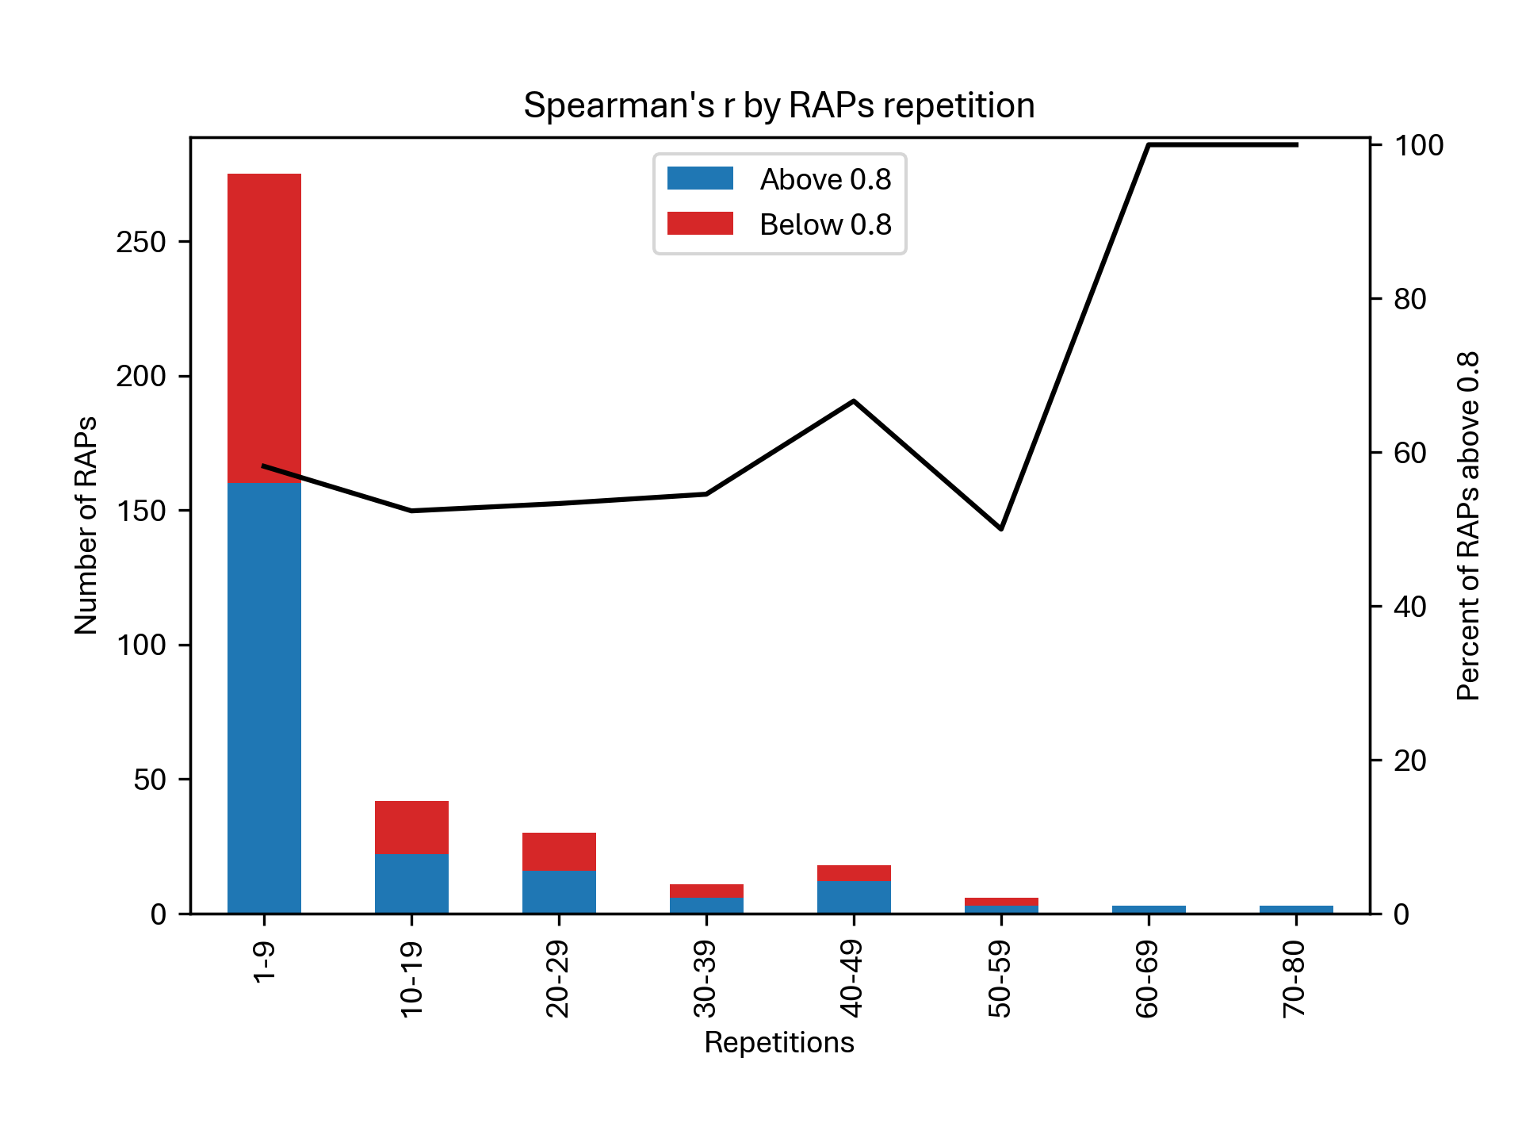
Spearman’s r vs RAPs repetition

Slide 28


Slope vs RAPs repetition

Slide 29


Intercept vs RAPs repetition

Slide 30
Pearson Correlation

Slide 31




Pearson correlation – Summary

Slide 32





Pearson correlation – All 7K

Slide 33


Pearson correlation – All 7K

Slide 34


Pearson correlation – Sheba

Slide 35


Pearson correlation – RAPs

Slide 36

Pearson correlation – With/Without DS

Slide 37


Pearson correlation – Streck Prot+ or cfDNA

Slide 38
Linear Regression: R^2

Slide 39




Linear Regression: R^2 – Summary

Slide 40


Linear Regression: R^2 – All 7K

Slide 41


Linear Regression: R^2 – Sheba

Slide 42


Linear Regression: R^2 – RAPs

Slide 43

R^2 – With/Without DS

Slide 44


R^2 – Streck Prot+ or cfDNA

Slide 45
Linear Regression: Slope

Slide 46




Linear Regression: Slope – Summary

Slide 47


Linear Regression: Slope – All 7K

Slide 48


Linear Regression: Slope – Sheba

Slide 49


Linear Regression: Slope – RAPs

Slide 50

Slope – With/Without DS

Slide 51


Slope – Streck Prot+ or cfDNA

Slide 52
Linear Regression: Intercept

Slide 53




Linear Regression: Intercept – Summary

Slide 54


Linear Regression: Intercept – All 7K

Slide 55


Linear Regression: Intercept – Sheba

Slide 56


Linear Regression: Intercept – RAPs

Slide 57

Intercept – With/Without DS

Slide 58


Intercept – Streck Prot+ or cfDNA

Slide 63
Pearson correlation – with/without DS

Slide 64
Pearson correlation – with/without DS

Slide 65
Conclusions

